Slide 1
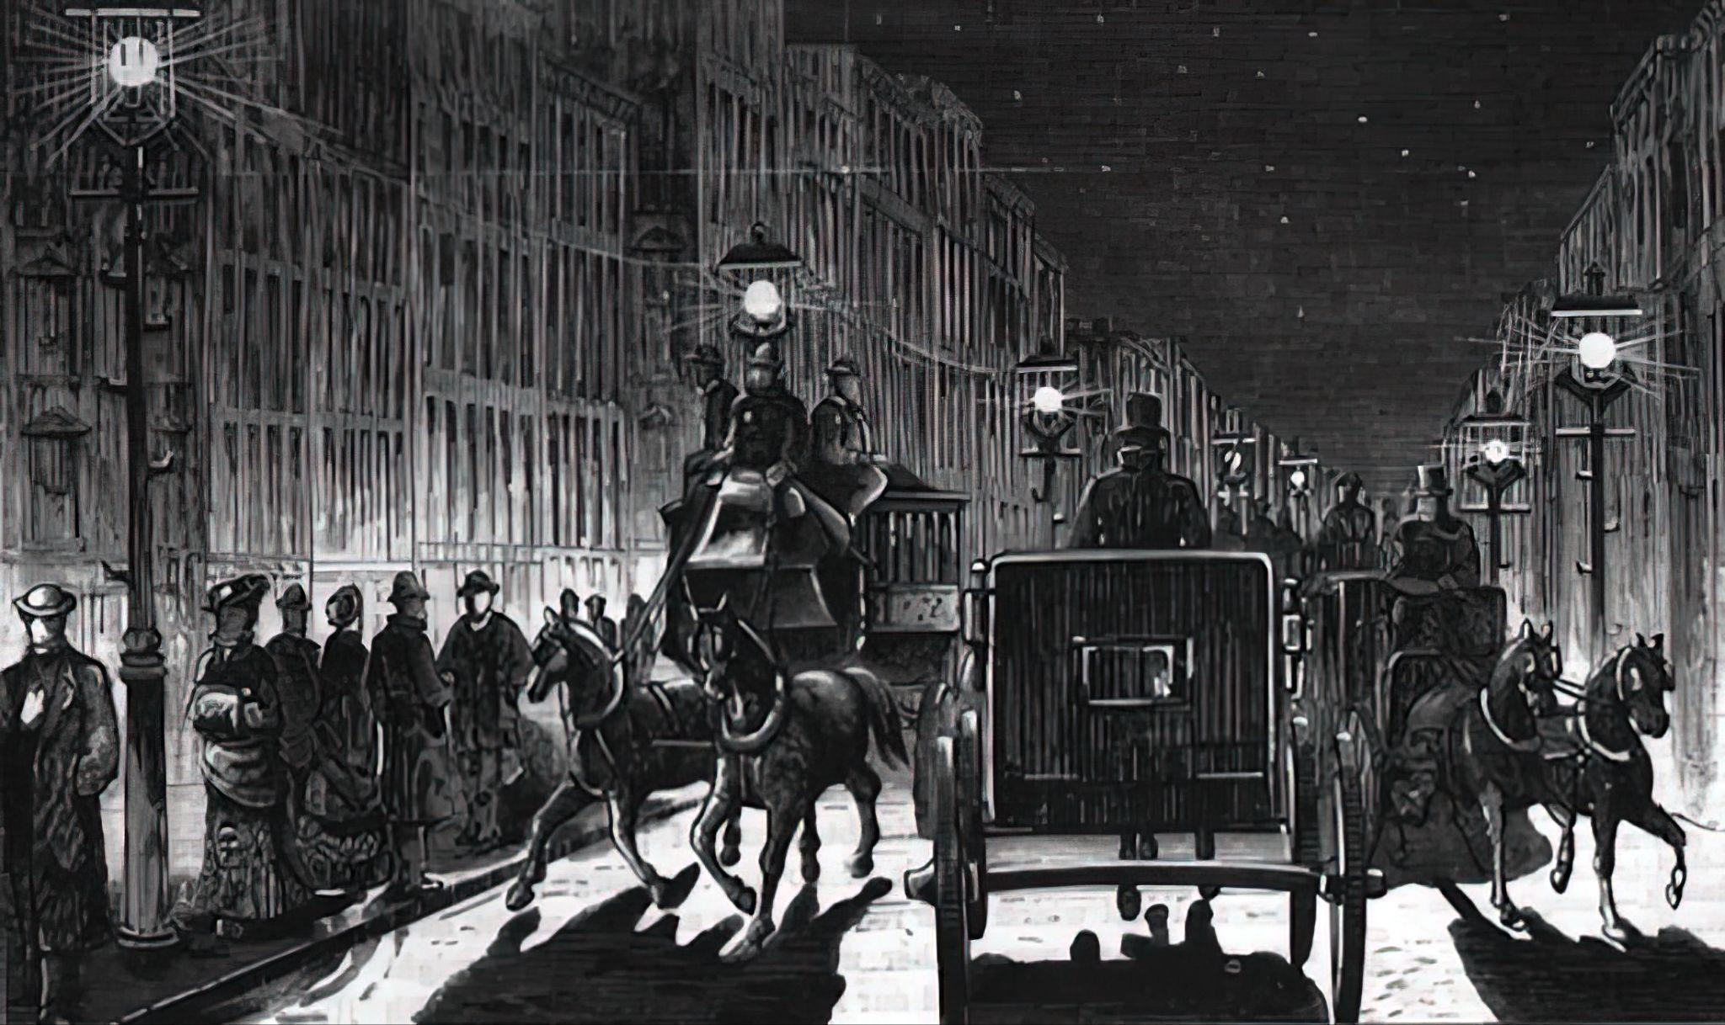
Courtesy Start Engineering
www.start-engineering.com
What is this great achievement?

Slide 2
ANSWER
Electrification
Electric power revolutionized the world, enabling countless other technologies and improving quality of life through lighting, heating, appliances, and industrial productivity.

Slide 3
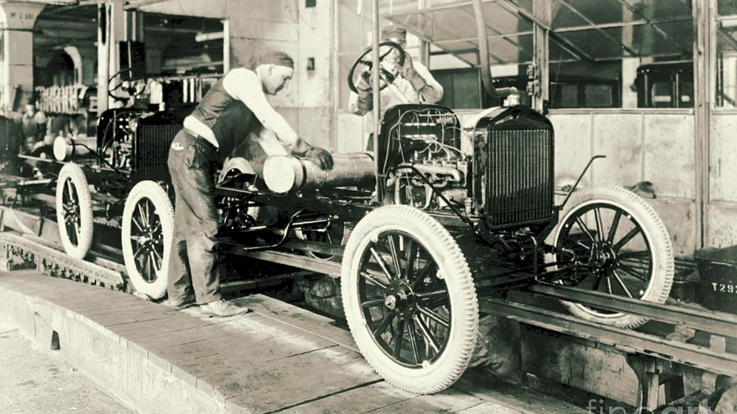
What is this great achievement?
What is this great achievement?

Slide 4
ANSWER
Automobile
Cars transformed transportation, reshaped cities, and made personal mobility and commerce more accessible and efficient.

Slide 5
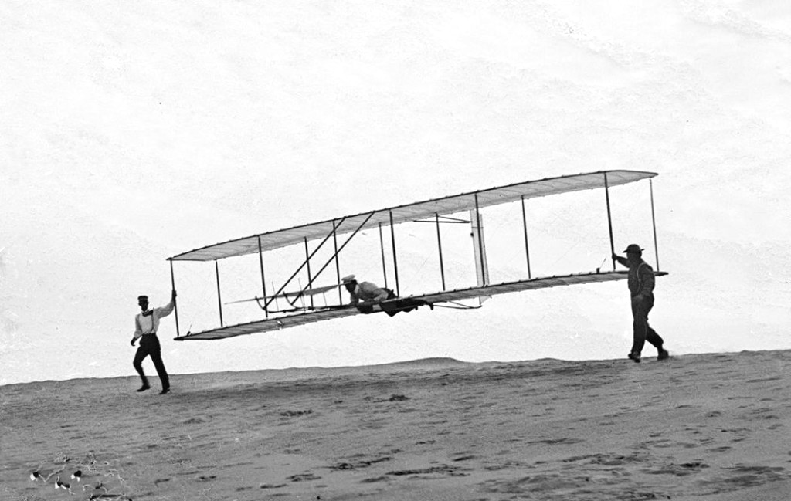
What is this great achievement?
What is this great achievement?

Slide 6
ANSWER
Airplane
Air travel connected the world faster than ever before, enabling global trade, tourism, cultural exchange, and military capabilities.

Slide 7
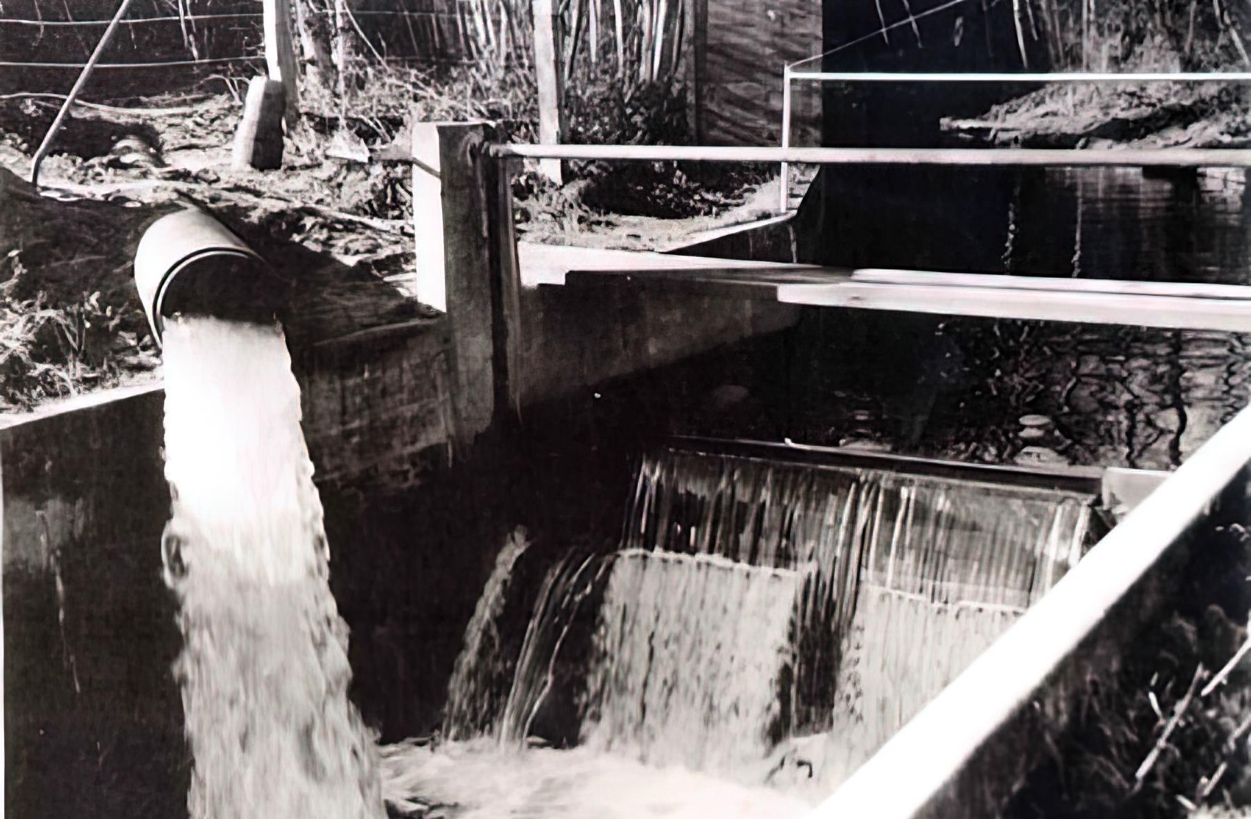
What is this great achievement?

Slide 8
ANSWER
Water Supply and Distribution
Clean water and plumbing infrastructure drastically reduced disease and mortality while supporting population growth and urban development.

Slide 9
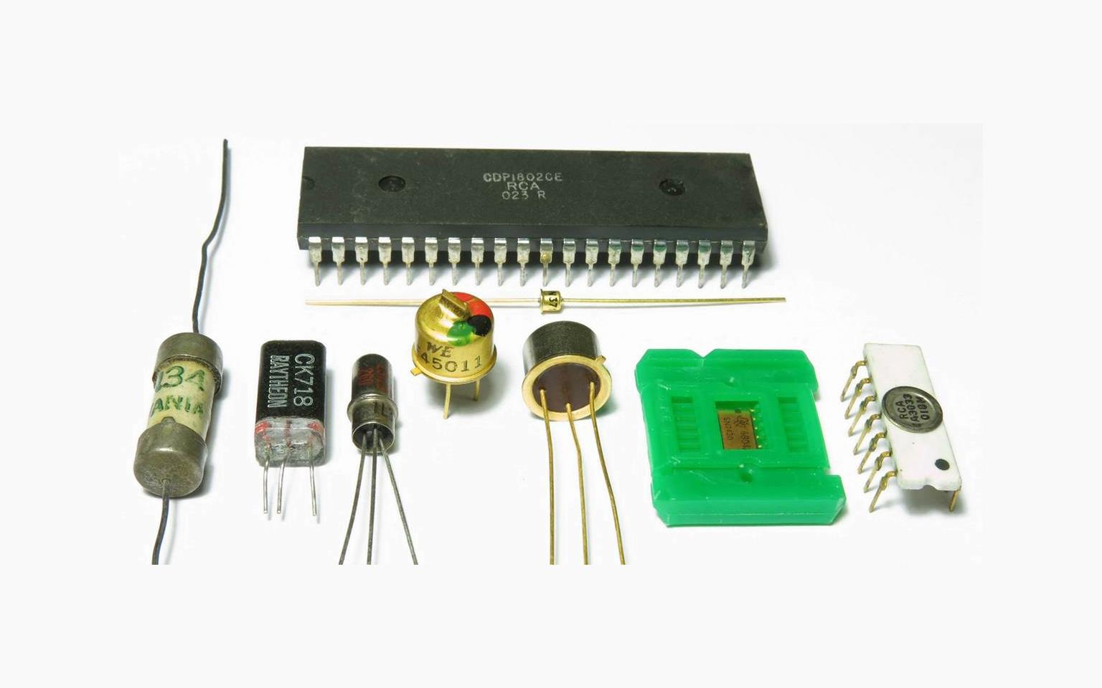
What is this great achievement?

Slide 10
ANSWER
Electronics
Semiconductors, transistors, and integrated circuits form the backbone of modern technology—from radios to computers and smartphones.

Slide 11
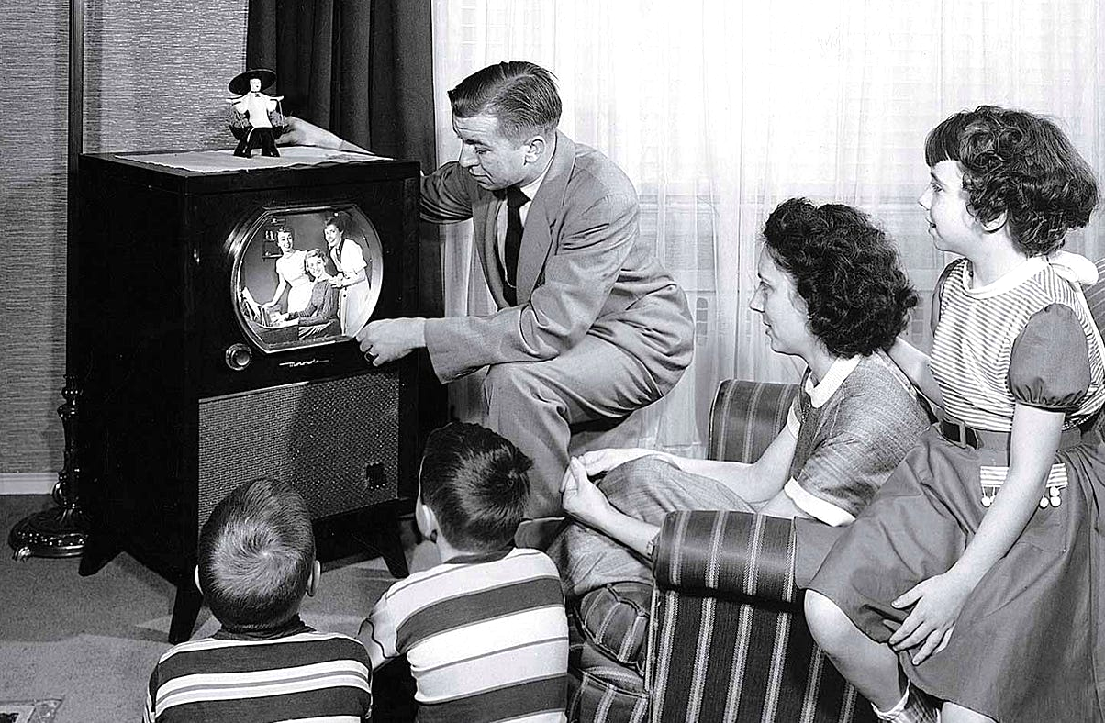
What is this great achievement?

Slide 12
ANSWER
Radio and Television
Mass communication through broadcast media reshaped news, entertainment, education, and advertising, connecting people across vast distances.

Slide 13
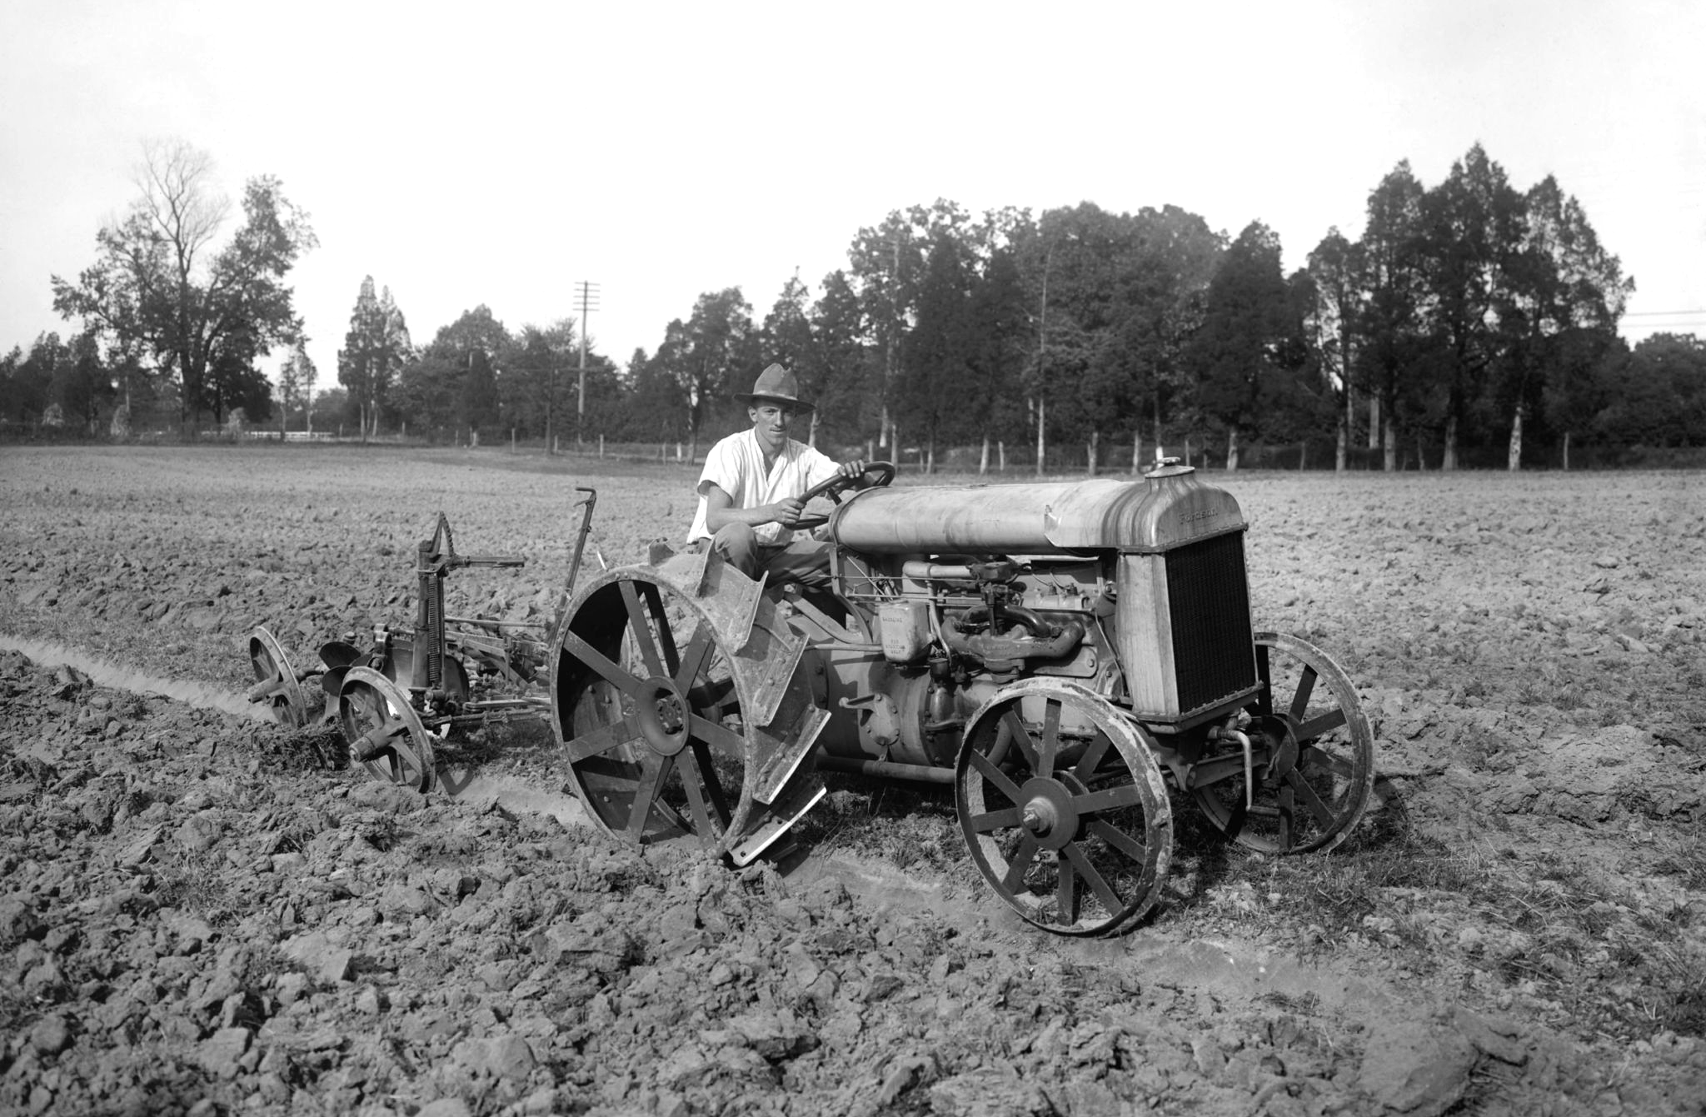
What is this great achievement?

Slide 14
ANSWER
Agricultural Mechanization
Tractors, harvesters, and irrigation systems increased food production, reduced labor, and made farming more efficient, supporting population growth.

Slide 15
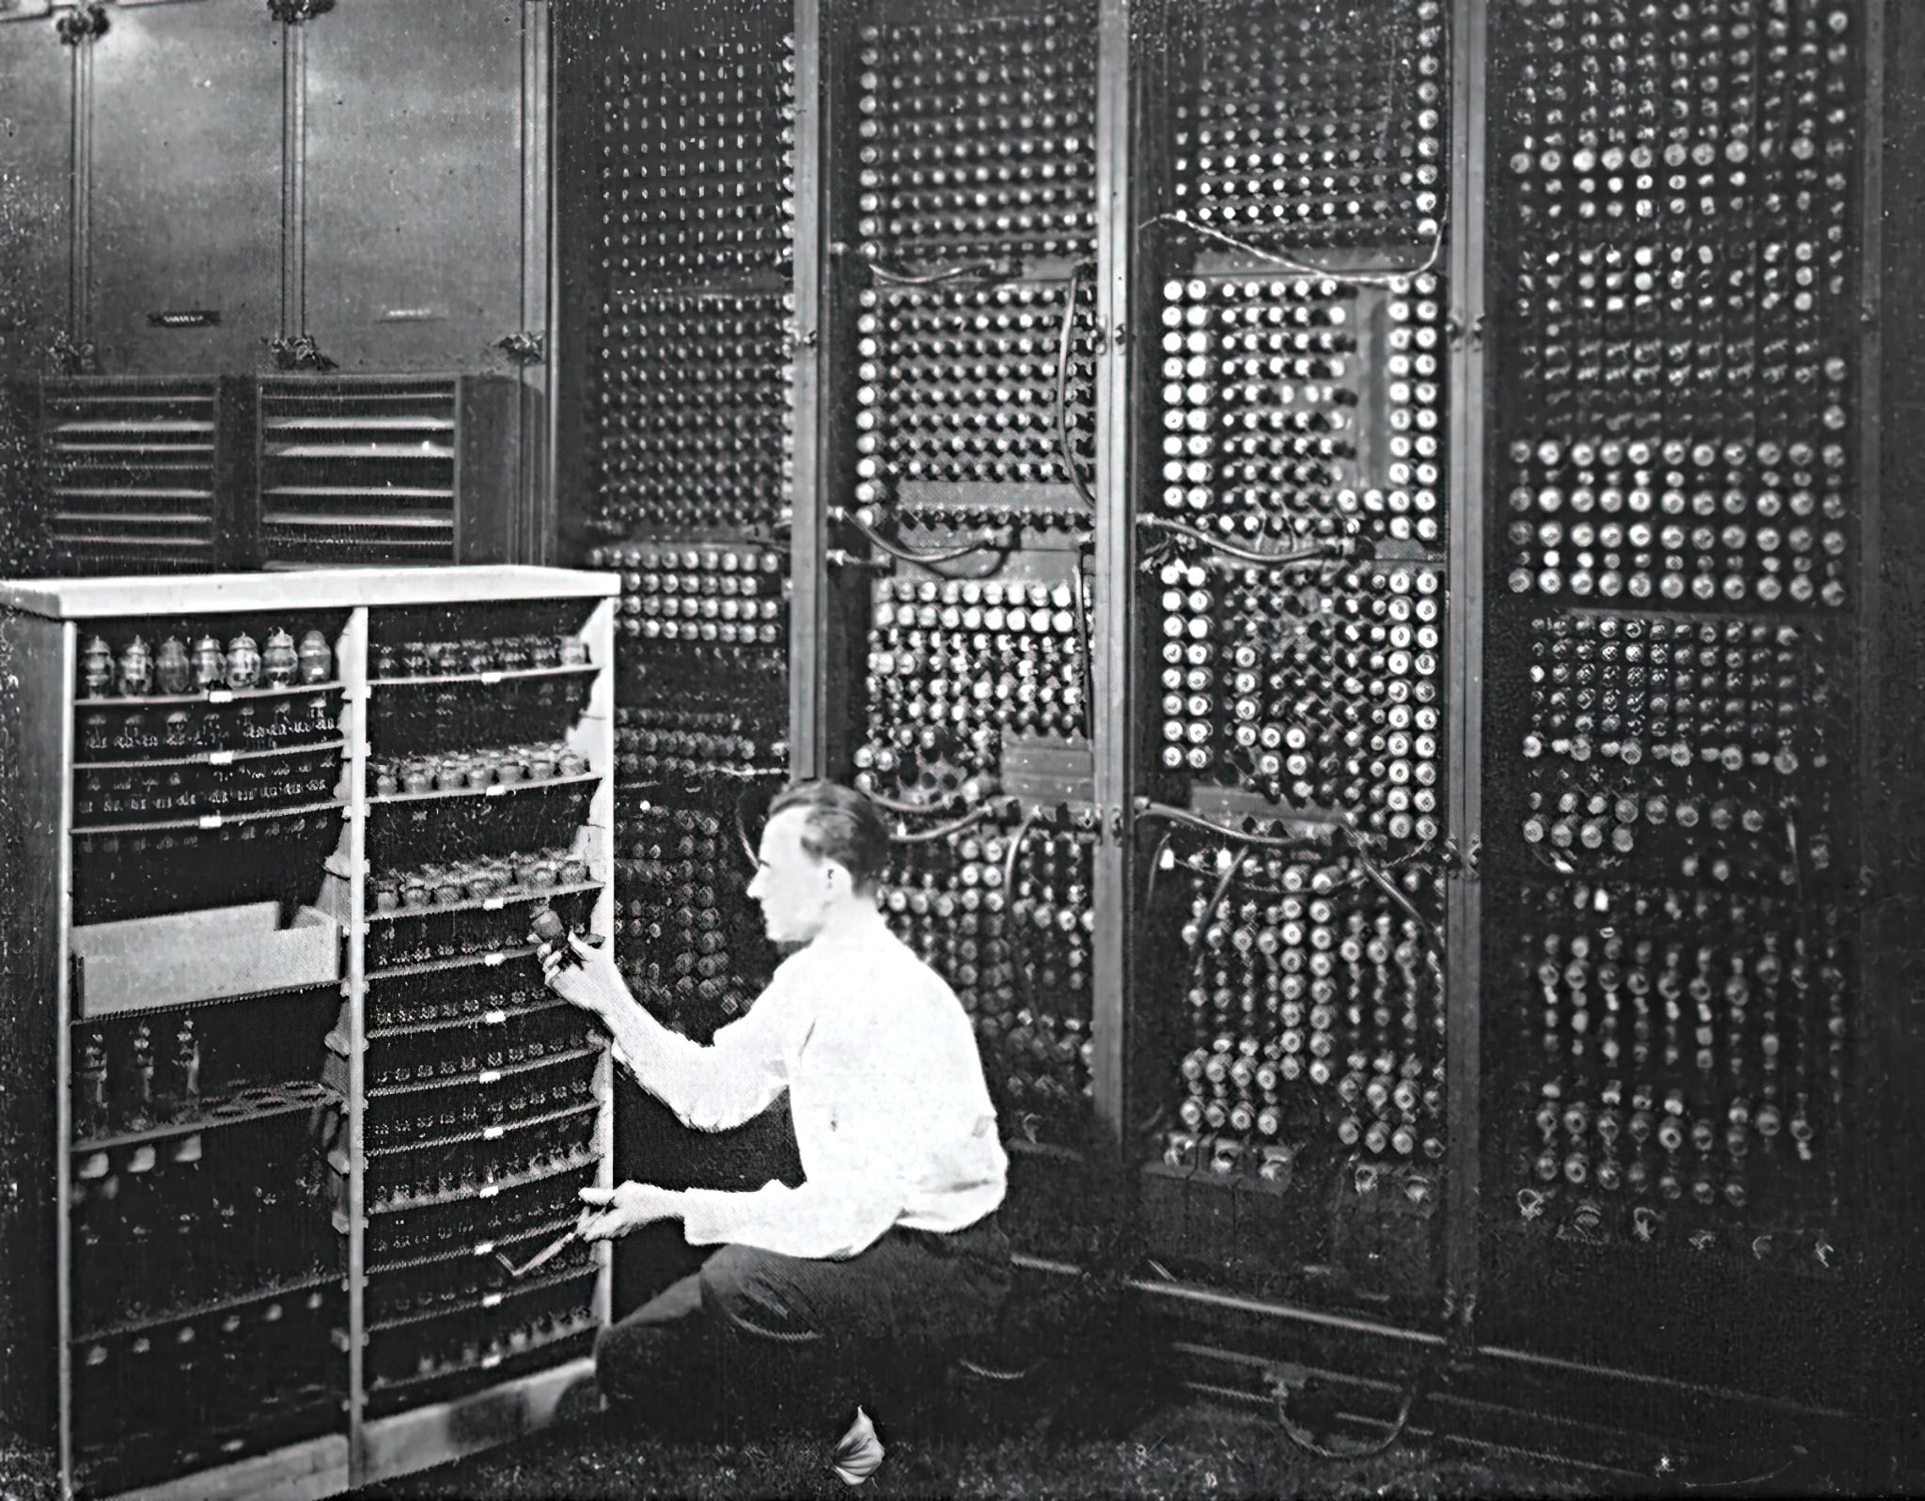
What is this great achievement?

Slide 16
ANSWER
Computer
Computing revolutionized nearly every industry, enabling complex calculations, automation, digital communication, and data processing.

Slide 17
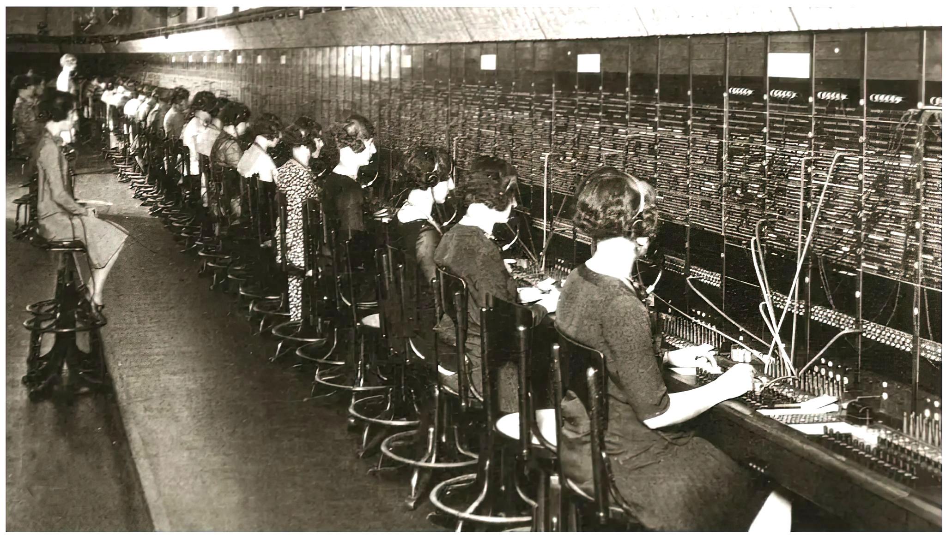
What is this great achievement?

Slide 18
ANSWER
Telephone
Wired and later wireless voice communication transformed business, personal relationships, and emergency response across the globe.

Slide 19
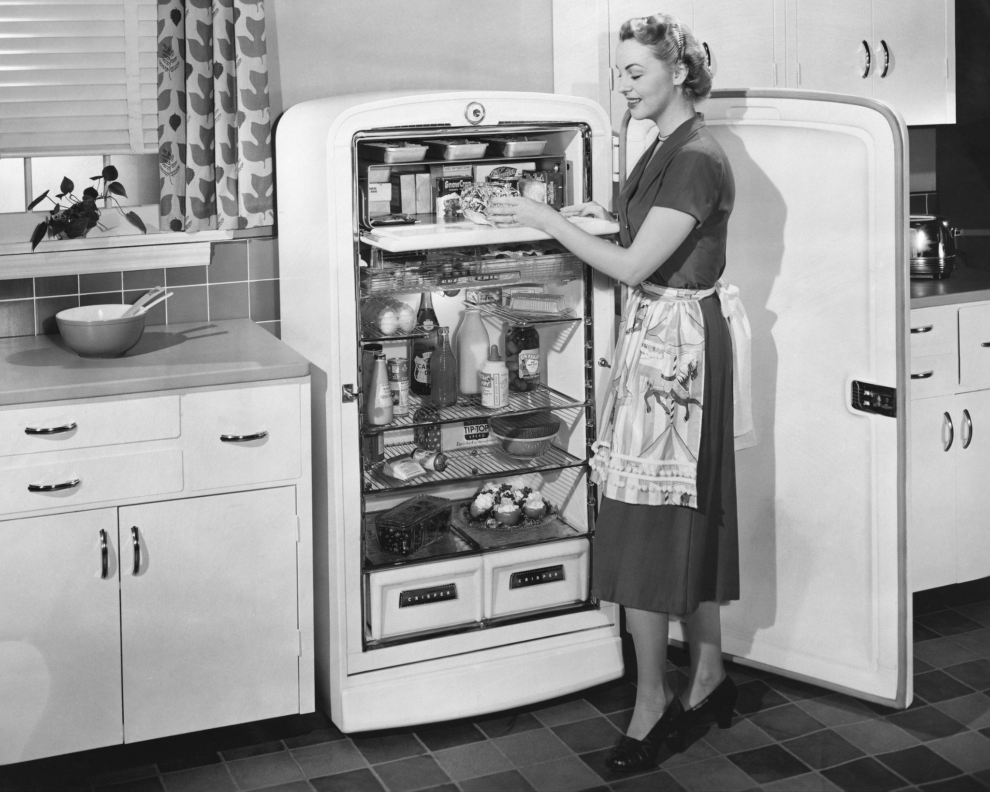
What is this great achievement?

Slide 20
ANSWER
Air Conditioning & Refrigeration
Improved comfort, productivity, and food preservation, influencing architecture, healthcare, and the food industry.

Slide 21
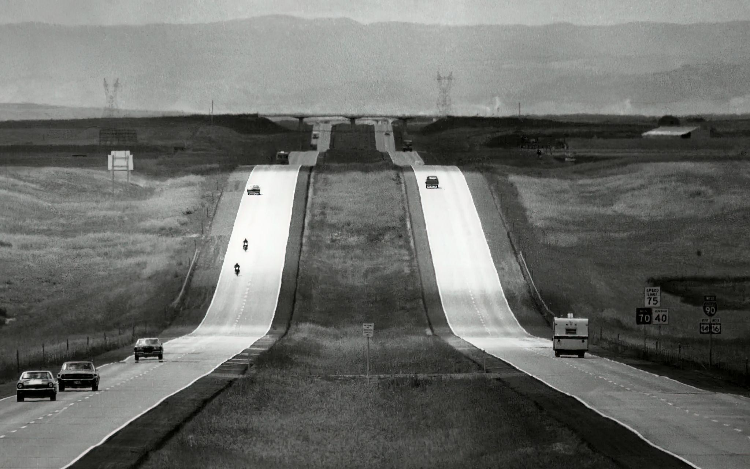
What is this great achievement?

Slide 22
ANSWER
Highways
Enabled efficient transport of goods and people, shaping economic development and urban sprawl.

Slide 23
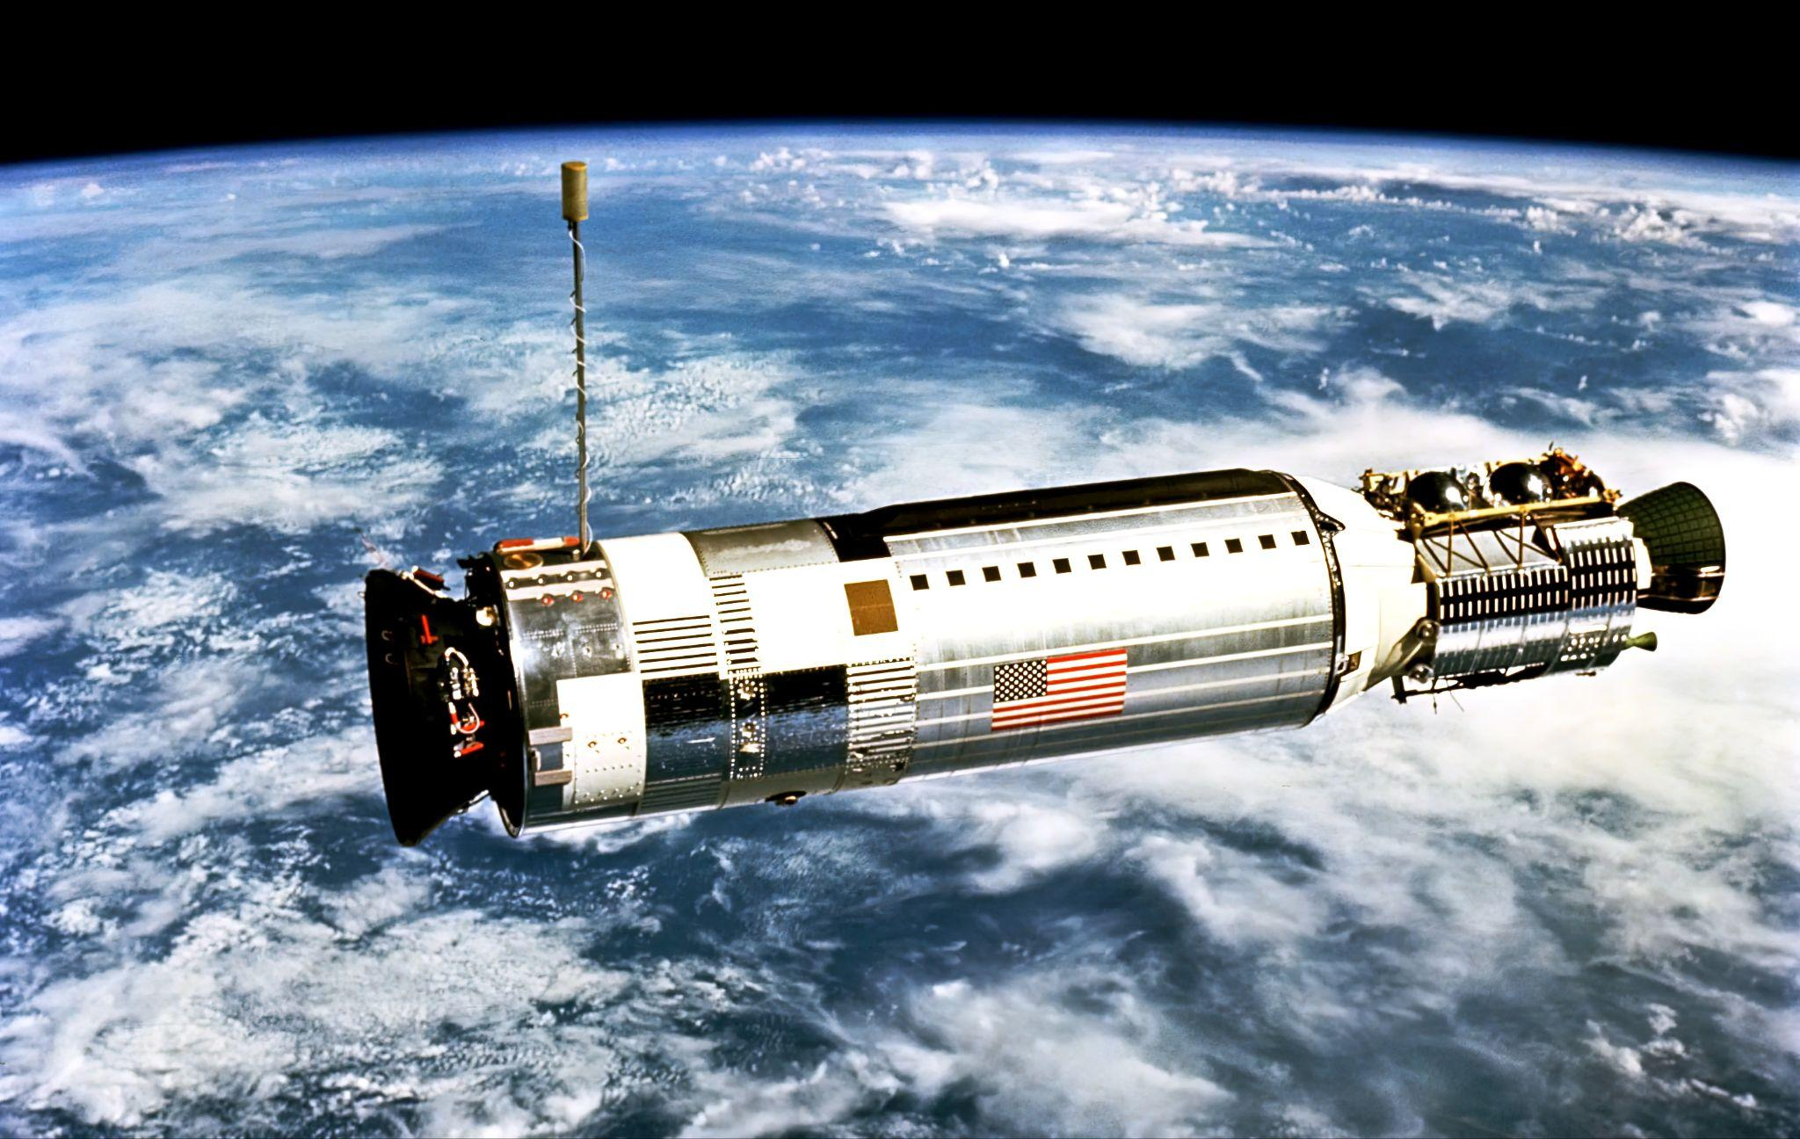
What is this great achievement?

Slide 24
ANSWER
Spacecraft
Satellites, space probes, and human missions expanded our understanding of space, improved communication, and introduced technologies later adapted for use on Earth.

Slide 25
What is this great achievement?

Slide 26
ANSWER
Internet
The global digital network transformed how we communicate, share information, conduct business, and learn, becoming a critical part of daily life.

Slide 27
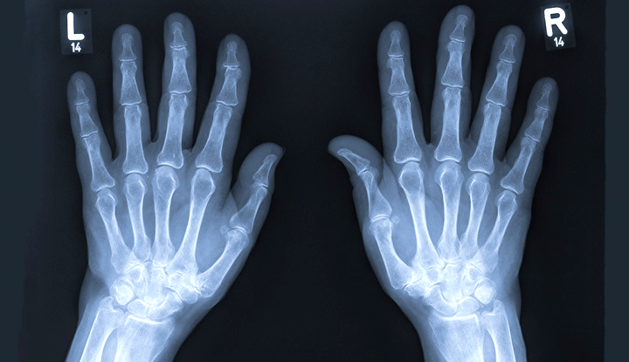
What is this great achievement?

Slide 28
ANSWER
Imaging
Technologies like X-rays, MRI, ultrasound, and CT scans revolutionized diagnostics, enabling earlier and more accurate treatment of disease.

Slide 29
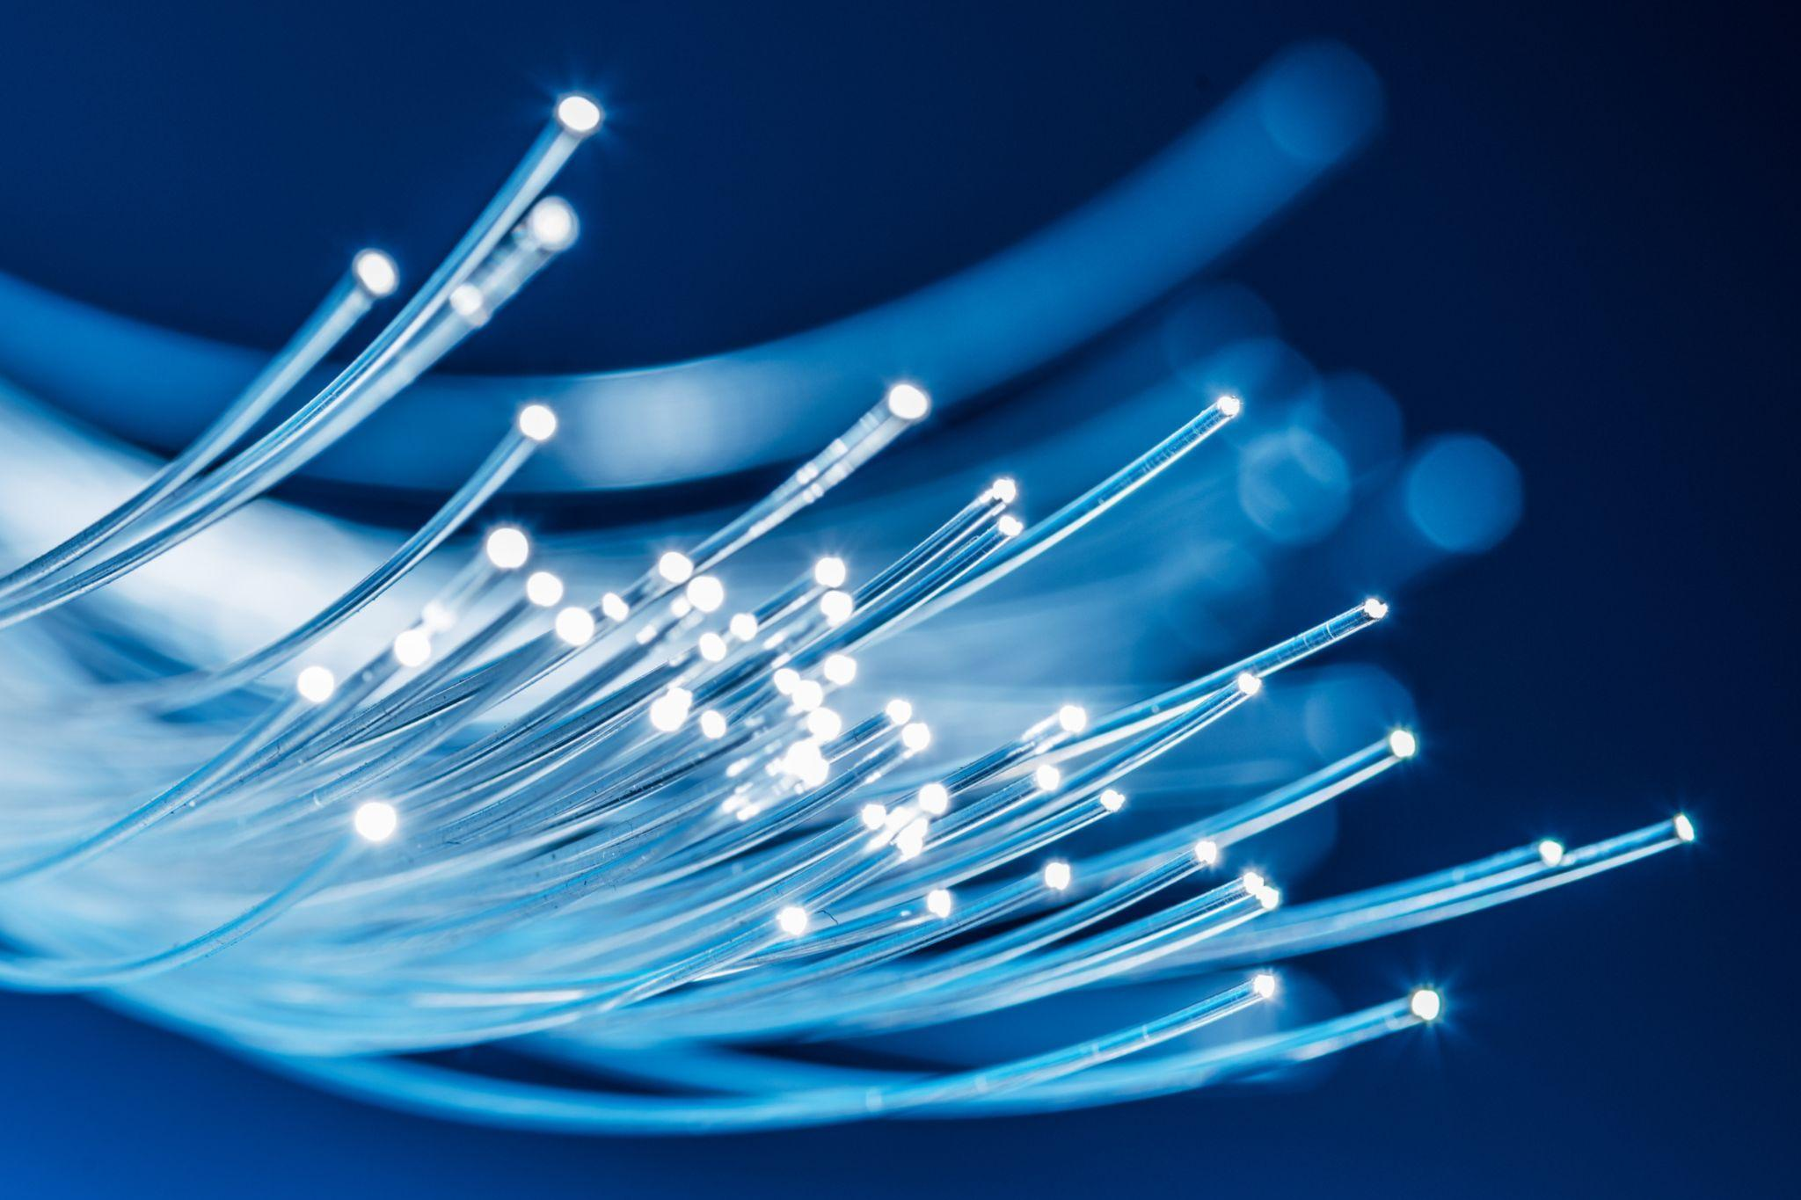
What is this great achievement?

Slide 30
ANSWER
Laser and Fiber Optics
These technologies enabled precision in medicine and manufacturing and revolutionized communication through high-speed data transmission.

