Slide 1
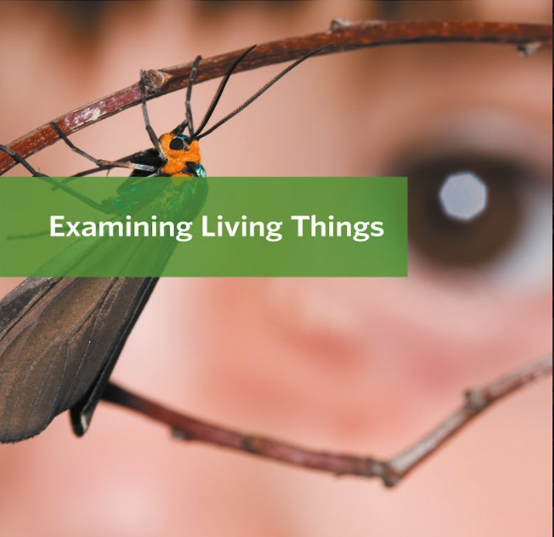
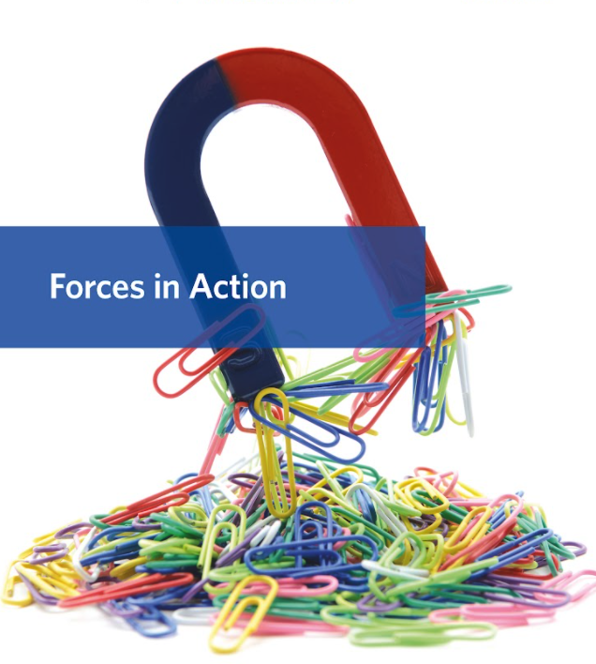
©2021 Activate Learning. Not for resale, redistribution, or use other than classroom use without permission.
Notes:
Kindergarten, Life Science: Plants and Animals
Activate Learning PRIME
©2021 Activate Learning

Slide 2
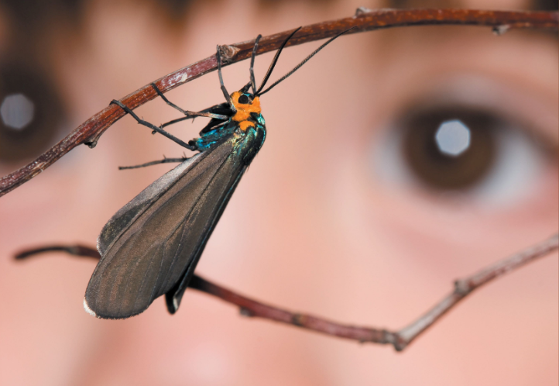
Cluster 2 - Plant Parts
Exploring Plant Parts
1
©2021 Activate Learning
Notes:
1
Kindergarten, Life Science: Plants and Animals
Examining Living Things
Cluster 2: Plant Parts
Exploring Plant Parts
Activate Learning PRIME
©2021 Activate Learning

Slide 3
Let’s get started
2
Notes:
2
Lesson Goals
1. Use the sense of touch to explore and describe the parts of a plant.
2. Complete a matching exercise pairing the different parts of a plant with their functions.
3. Read about and discuss how the structures of different plant parts are related to their functions.
Activate Learning PRIME
©2021 Activate Learning

Slide 4
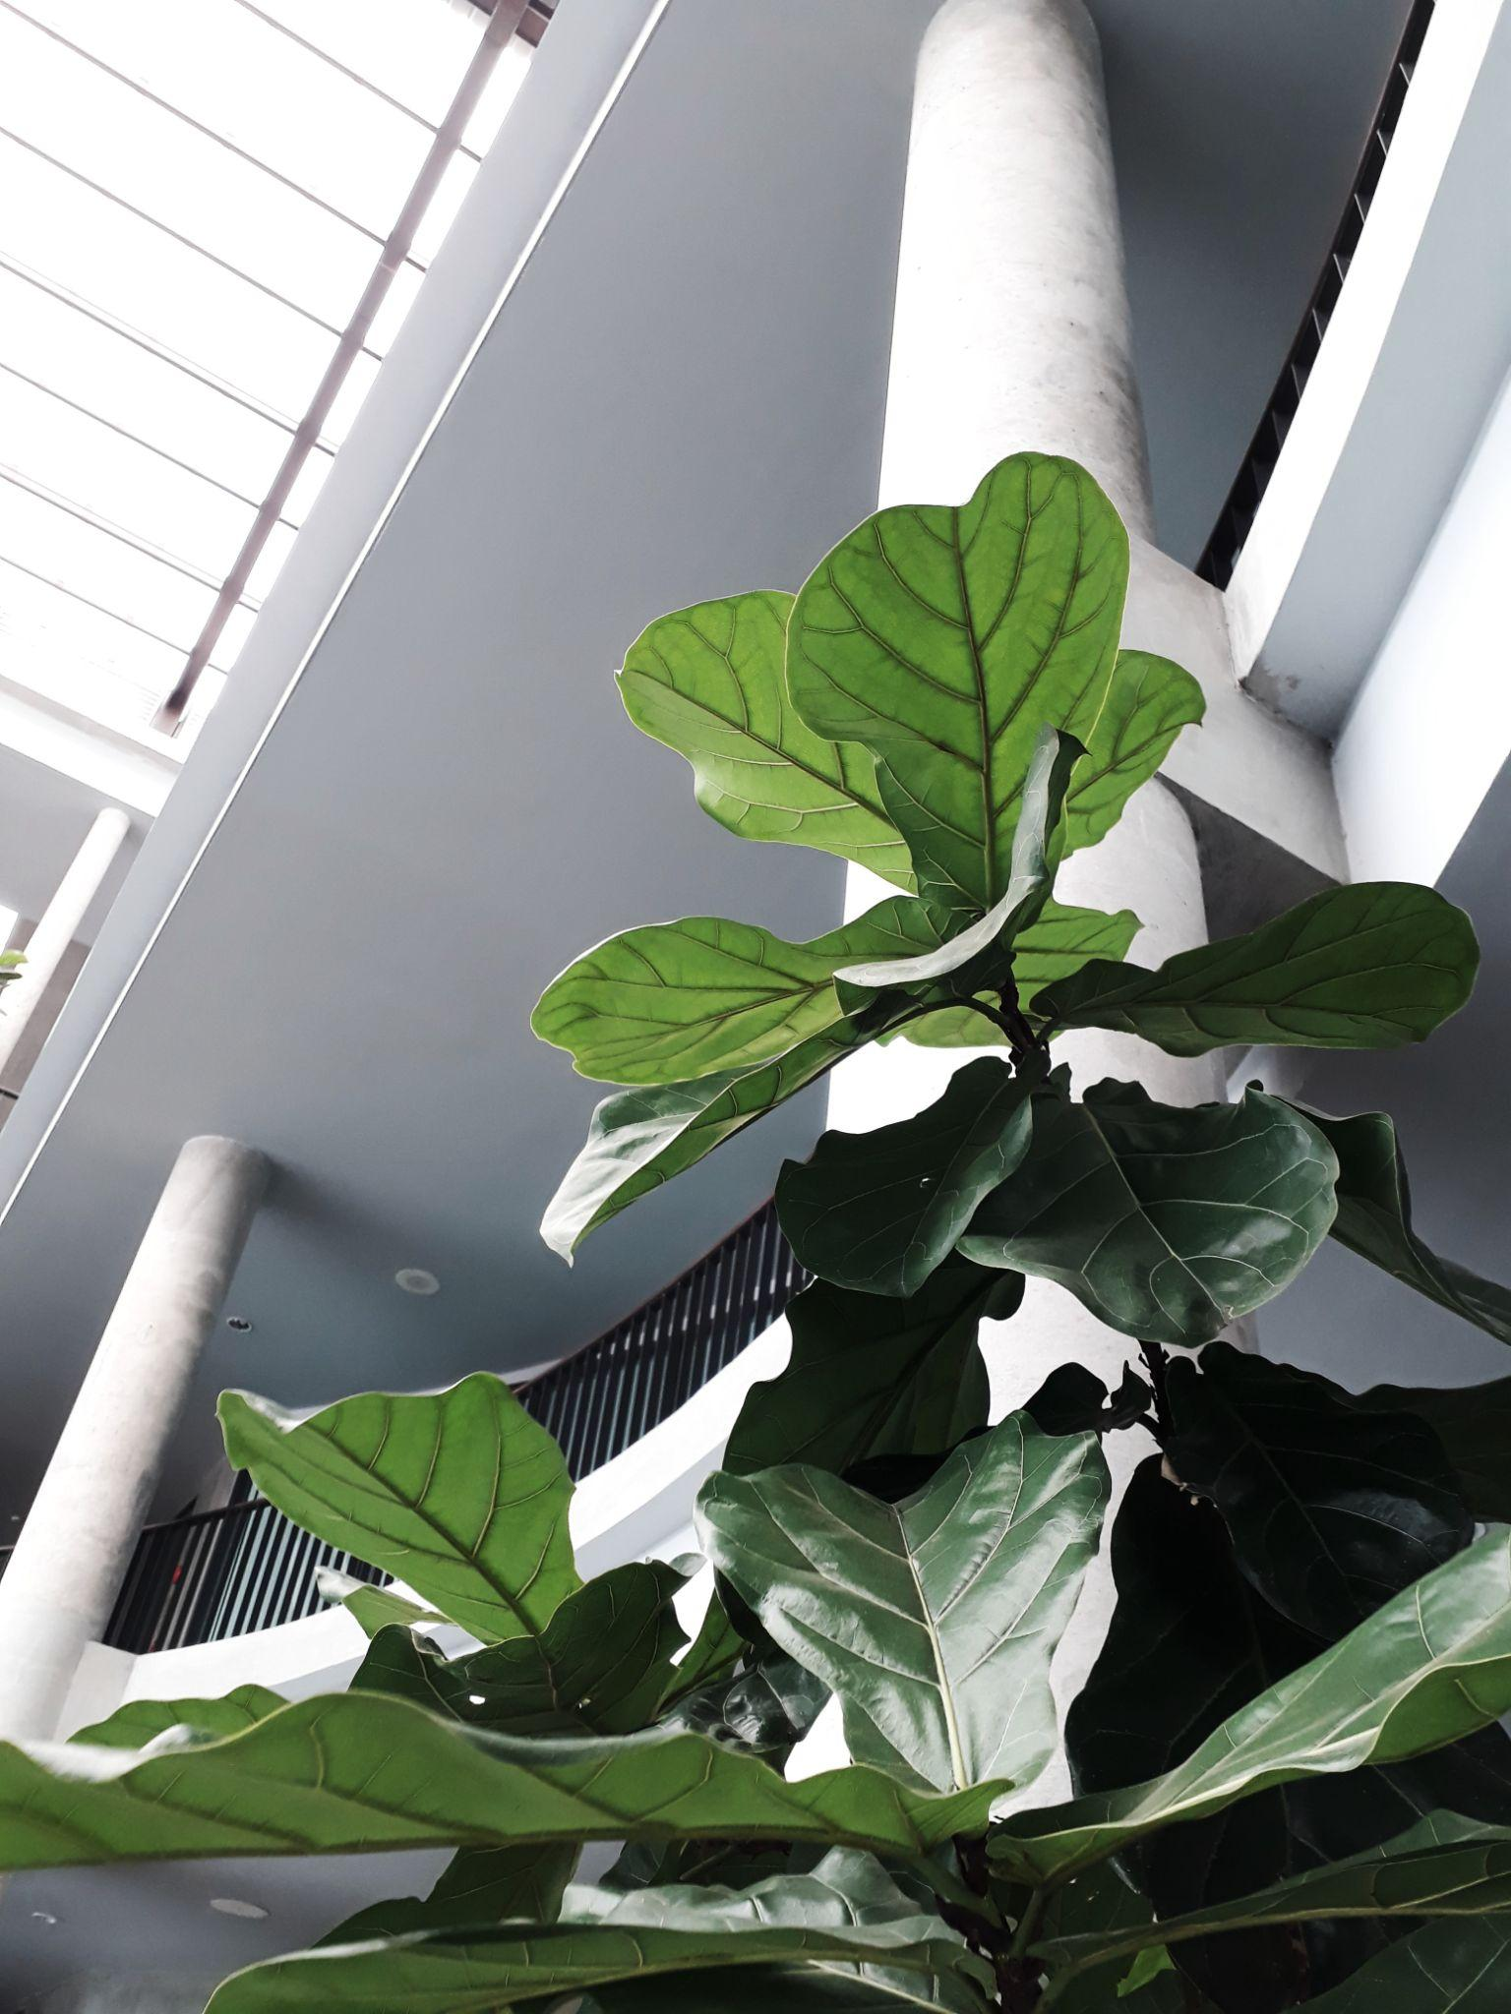
What parts of this plant can you see?
Is there a part of the plant that we can’t see?
3
Notes:
3
Explore: Introductory Discussion
Hold up one of the potted plant starts and ask children to identify the parts they know.
They may be familiar with parts such as flowers and leaves, but may need to be prompted about stems, roots, or any seeds or fruits.
Ask children:
What parts of this plant can you see? (leaves, flowers, seeds, fruits, stem)
Is there a part of the plant that we can’t see? (roots)
Activate Learning PRIME
©2021 Activate Learning

Slide 5
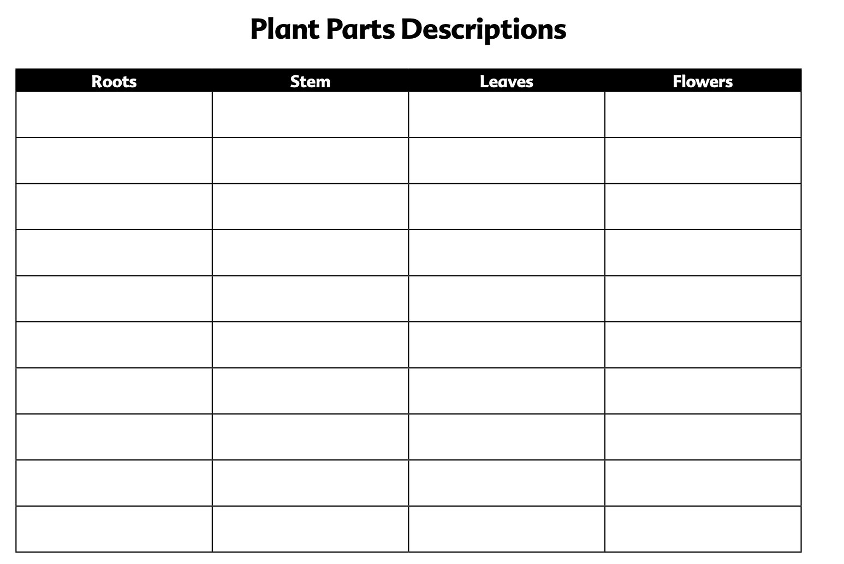
4
Notes:
4
Engage: Sensory Observation
Tell children they will be exploring a plant using their sense of touch.
Divide them into groups.
Distribute one copy of the Teacher Master Plant Parts Descriptions to each group and assign one child to take notes on it. Distribute a paper plate with a plant and a blindfold to each group.
Explain to the children that they will leave the plants in the pots because they will use them again in the next lesson.
Tell groups to help one child put on the blindfold, and to guide his or her hands to the plant on the plate. Remind them to handle the plant very gently.
Have group members to take turns asking the blindfolded child to touch the stem, leaves, flowers (and fruits/seeds, if present) on the plant and to call out words to describe it.
Have the note taker write the words in the corresponding column of the Teacher Master. Ensure that the note taker for the group also has a turn to explore the plant.
When all group members have had a turn with the blindfold, have children examine the plant with their eyes and record any additional descriptive words on the Teacher Master.
Activate Learning PRIME
©2021 Activate Learning

Slide 6
What did you notice when you touched the plant?
What did you notice when you saw the plant?
What other senses could you use to find out about the plant?
5
Notes:
5
Engage: Sensory Observation
Ask:
What did they notice about the plants when they could only use their sense of touch?
What did they notice when they also used their sense of sight? Did they notice anything new or different?
What other senses could they use to find out more about the plant?
Gather the groups’ lists of descriptive words to be placed in the Science Center. These can serve as a word bank for the Language Arts Extension.
Place the plants in the Science Center or on a sunny windowsill and water them generously. The plants will be used later in the Examining Roots lesson.
Activate Learning PRIME
©2021 Activate Learning

Slide 7
6
Notes:
6
Explore: What Plant Parts Do
Read the Plant Parts student reader aloud. Explain to children that what they learn from the reading may help them with the next activity.
Activate Learning PRIME
©2021 Activate Learning

Slide 8
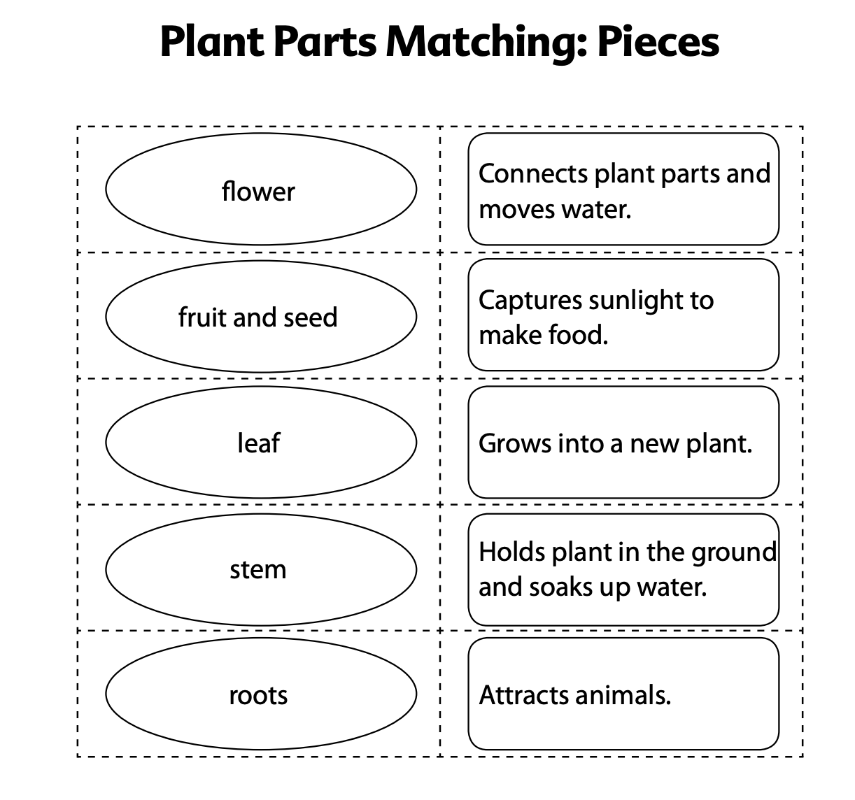
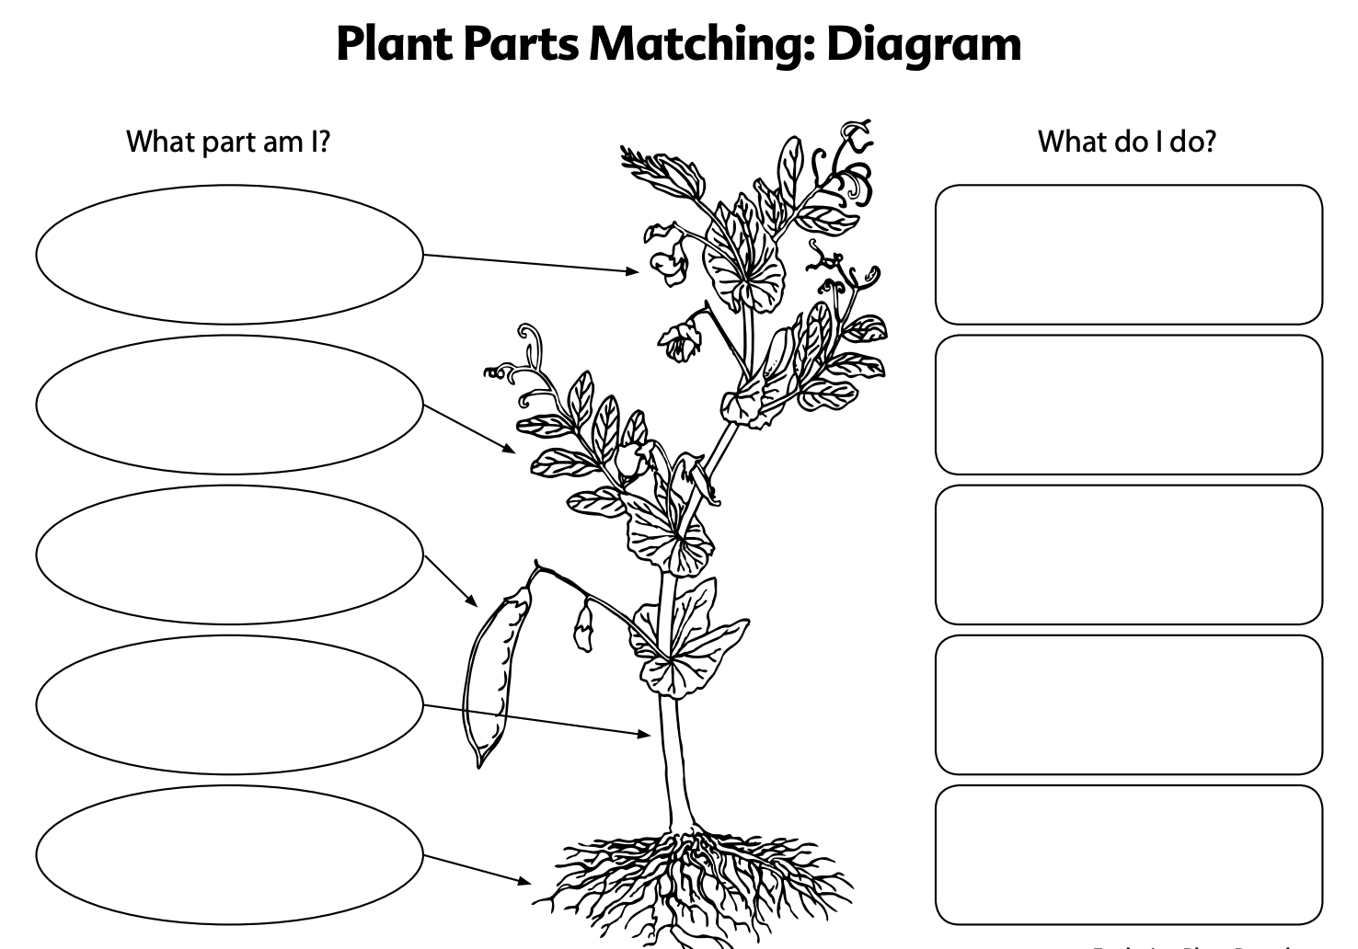
7
Notes:
7
Explore: Matching Exercise
Assign children to pairs.
Distribute copies of the Teacher Masters Plant Parts Matching: Diagram and Plant Parts Matching: Pieces, scissors, and glue sticks to the children.
Instruct children to cut out the circles and squares from the Plant Parts Matching: Pieces and paste them onto the appropriate rectangles on the Plant Parts Matching: Diagram.
Encourage children to work together to read the different pieces and match the different plant parts with what they do for the plant. Tell children to make their best guesses if they are not sure.
Circulate throughout the room and assist children as needed.
Activate Learning PRIME
©2021 Activate Learning

Slide 9
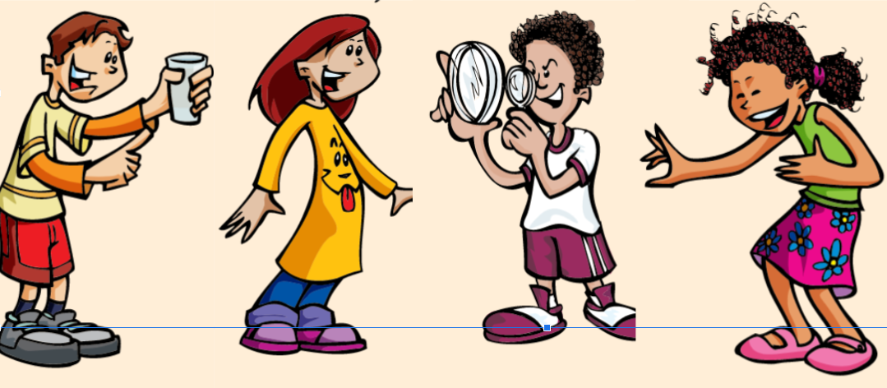
Share your descriptive words for each part of the plant
8
Notes:
8
Big Idea: Plants are living things. They have many parts that work together to help them grow and make new plants.
Reflect and Discuss: Sharing
Remind the children that they explored the different parts of a plant using their senses of touch and sight and listed descriptive words for each part.
Explain that one of the most important skills that scientists need is to be able to describe what they sense. Have the children share some of their descriptive words for each part of the plant.
Activate Learning PRIME
©2021 Activate Learning

Slide 10
Reflect and Discuss
What do roots do?
How does being stringy help the roots hold the plant in the ground?
How does being hairy help the roots to soak in water?
9
Notes:
9
Big Idea: Plants are living things. They have many parts that work together to help them grow and make new plants.
Reflect and Discuss: Synthesizing
Tell children that now they are going to think some more about how the shape of different plant parts helps the part to do their job for the plant.
Have children reflect upon what they learned about roots.
Ask:
What do roots do? (They hold the plant in the ground and soak in water.)
How does being stringy like a ball of yarn help the roots hold the plant in the ground? (Being stringy lets the roots grow between all of the rocks and sand in the soil to hold the plant firmly in the ground.)
How does being hairy help the roots to soak in water? (Having a lot of little hairs lets the roots spread out and grow between all of the rocks and sand in the soil to get water.)
Activate Learning PRIME
©2021 Activate Learning

Slide 11
Reflect and Discuss
What do stems do?
How does being long help the stem do its job?
10
Notes:
10
Big Idea: Plants are living things. They have many parts that work together to help them grow and make new plants.
Reflect and Discuss: Synthesizing
Have children reflect upon what they learned about stems.
Ask:
What do stems do? (They connect the different parts and move water throughout the plant.)
How does being long help the stem do its job? (Being long helps the stem move water all the way from the roots to the leaves. It helps to connect parts of the plant that are far away from each other.)
Activate Learning PRIME
©2021 Activate Learning

Slide 12
Reflect and Discuss
What do leaves do?
How does being flat help leaves to capture sunlight?
11
Notes:
11
Big Idea: Plants are living things. They have many parts that work together to help them grow and make new plants.
Reflect and Discuss: Synthesizing
Have children reflect upon what they learned about leaves.
Ask:
What do leaves do? (They capture sunlight to make food for the plant.)
How does being flat help leaves to capture sunlight? (Being flat and spread-out allows a leaf to capture as much sunlight as possible for the plant.)
Activate Learning PRIME
©2021 Activate Learning

Slide 13
Reflect and Discuss
What do flowers do?
12
Notes:
12
Big Idea: Plants are living things. They have many parts that work together to help them grow and make new plants.
Reflect and Discuss: Synthesizing
What do flowers do? (Make fruits and seeds.)
Activate Learning PRIME
©2021 Activate Learning

Slide 14
Big Idea: Plants are living things. They have many parts that work together to help them grow and make new plants.
13
Notes:
13
Big Idea: Plants are living things. They have many parts that work together to help them grow and make new plants.
Activate Learning PRIME
©2021 Activate Learning

Slide 15
14
Notes:
14
Post to the Driving Question Board (DQB)
Groups’ lists of descriptive words for plant parts
Sample(s) of children’s completed Plant Parts Matching diagrams
Post the Big Idea: Plants are living things. They have many parts that work together to help them grow and make new plants.
Scan the DQB for any questions that can serve as a bridge to the next activity. Ask the students what do roots do for plants?
Activate Learning PRIME
©2021 Activate Learning

Slide 16
15
Notes:
15
Possible Activities for the Science Center
Observing the plants and adding descriptive words to their lists Materials: potted plant starts, variety of books about plants
Activate Learning PRIME
©2021 Activate Learning

Slide 17
Assessment Options
16
Notes:
16
Assessment Options
Consider using the Plants rubric during the reflective discussion to gauge children’s understanding of the structure and function of plant parts. Revisit this rubric throughout this cluster to track the children’s progress.
Activate Learning PRIME
©2021 Activate Learning

