Slide 1
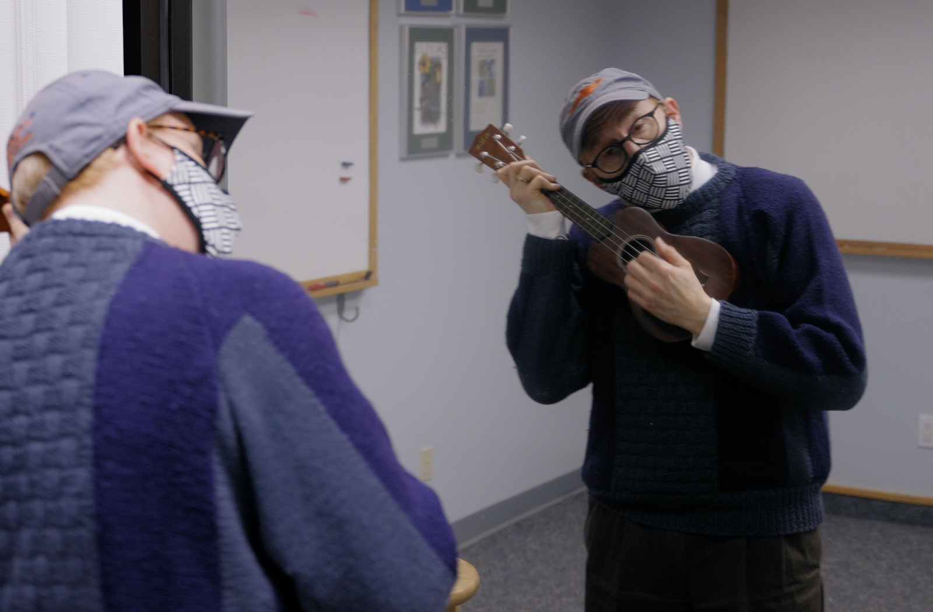
Slide A
Explore an Interesting Phenomenon
Make a 2-column chart on a blank page on the left side of your science notebook and record what you notice and wonder about.
Notice
Wonder
Watch the video closely and record things you notice and wonder about.
INDIVIDUAL WHOLE CLASS
Notes:
OpenSciEd Middle School
Unit 6.1, Lession 1, Day 1
Introduce the anchoring phenomenon. Frame the introduction to the phenomenon by saying, I have a video with an interesting phenomenon in it that may make you wonder what's happening and how it works. Let's watch this video together to figure out what's going on.
Prepare science notebooks to record noticings and wonderings. Have students draw a two-column chart to record noticings and wonderings.
Watch the mirror-window video. Play the Music Lesson video from https://youtu.be/ocs6BXQPOgg Pause the video for students to record their ideas. Play it again if time permits. When the video concludes, give students a few minutes to add to their Notice and Wonder chart.

Slide 2
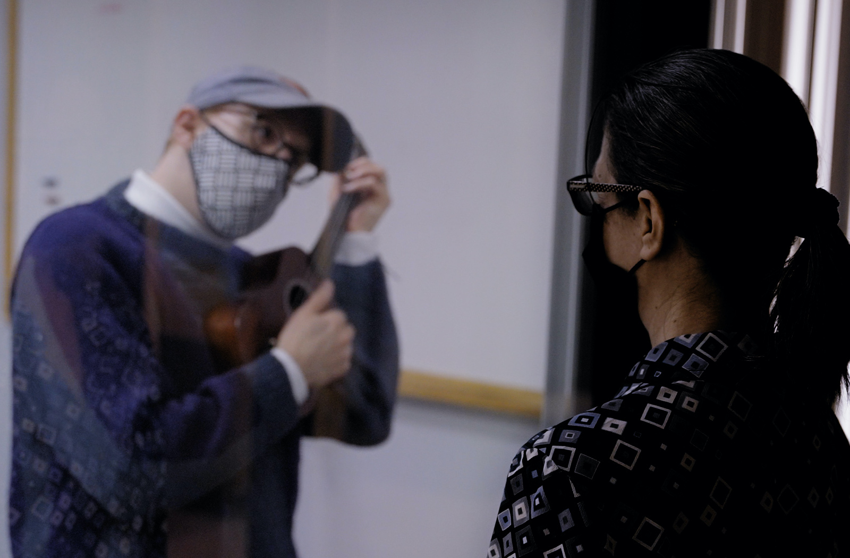
Slide B
Share Noticings and Wonderings
What did you notice happening in the video? What did you wonder about?
Notes:
Share noticings in whole-class discussion. Prompt students to share their noticings from the video. Probe deeper into a few observations to build a sense of mystery or to clarify. Record students’ observations on the “What we notice” or “Notice” side of the class Notice and Wonder chart. Point out that many of the noticings identified the material as glass or a mirror. Say, It’s really strange that this thing in the video can act like a mirror on one side and a window on the other side.
Repeat the sharing process for wonderings. Take a moment to draw attention to the role that asking questions will play in your classroom. Emphasize that, as a learning community, we are asking questions about why certain things are happening in the video, and by investigating our questions, we will be able to figure it out.
Pose the question we need to figure out. Say, There are a lot of observations here about this thing being like a mirror or a piece of glass, kind of like a window. And questions about what it's made of and how it works. How can something act like a mirror and a window at the same time? We need to figure this out.

Slide 3
Slide C
What do we think is happening?
Turn and Talk
Why do the adults see the music student?
Why does the music student see themself and not the adult?
Notes:
Turn and talk about initial explanations for the mirror-window phenomenon. Give students a couple minutes to discuss the slide’s questions with a partner:
Why do the adults see the music student?
Why does the student see themself and not the adults?
If students are not familiar with the Turn and Talk activity structure, take time now to introduce it and explain what is expected of them when they engage in partner talk (e.g., taking turns to listen carefully to each other, not talking over each other, not getting off topic).

Slide 4
Slide D
Initial Explanations
What “parts” or “components” from the scene in the video do we think are important for explaining the phenomenon?
What’s not important?
What are we not certain about?
Notes:
Although this activity engages students in systems thinking, wait to name it as such until day 4, when they can reflect on their use of this kind of thinking. For now, describing parts and interactions will help to scaffold students’ initial models for explaining the phenomenon in the video.
Identify the important parts to guide initial explanations. Show students the Parts chart. Ask, If we want to explain what’s happening in the video, what are the important parts we need to include in our explanation? Have the class work together to evaluate whether a part in the video is important, not important, or not sure. Ask the following question about each part students propose to include:
If the part was changed or missing, would it change the phenomenon?
If so, it’s important to include.
If not, it’s not important to include.
If we don’t know, then we’re uncertain about it.
As a decision is made for each proposed part, list the part in the appropriate column of the class chart. Once the class reaches agreement, say, This is a good start to figuring out how this phenomenon works. We can add more parts later if we think we missed something important. Let’s use our list to make a diagram that helps us explain how the important parts are interacting.

Slide 5
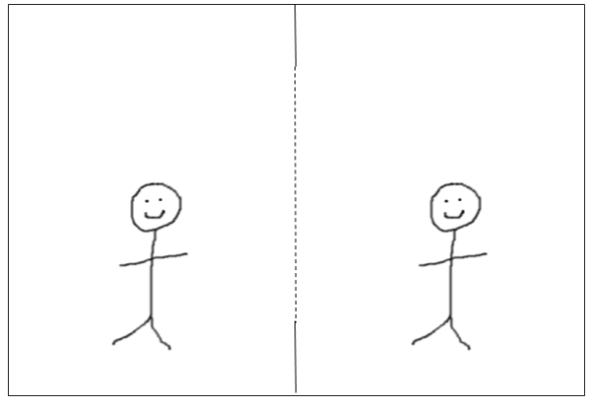
Slide E
Develop a Diagram
Write these two questions in your science notebook:
Why do the adults see the music student?
Why does the music student see themself and not the adults?
Create a diagram to explain as much as you know about the two questions.
Include all the important parts we agreed on and label them.
Use pictures, symbols, and words to explain how the parts interact to cause the phenomenon.
Record questions that you have if you become stuck.
Mirror-Window Phenomenon
Mirror-Window Diagram
Why do the adults see the music student?
Why does music student see themself and not the adults?
Notice
Wonder
Notes:
Diagram interactions between the important parts. Choose whether you want students to use the handout or diagram directly in their science notebook.
If the handout is selected, distribute one copy to each student. Modify this slide accordingly. Ask students to check that the diagram on the handout includes all the important parts we identified. Prompt them to add important parts from the class list if the diagram is missing them.
If students are to diagram in their science notebook, display this slide (as is). Ask students to write the title “Mirror-Window Diagram” and the slide’s two questions at the top of the next page in their notebook and then draw the diagram, making certain to include the important parts from the class list.
Once students get all the important parts into the diagram and labeled, ask them to add pictures, symbols, and words to show how the parts work and interact to answer the two questions, as their initial attempt to explain the phenomenon.
Give students up to 5 minutes to work individually to diagram what they think is happening. Use this diagram as a formative assessment to monitor students’ initial ideas about how we see objects; specifically, the extent to which their models reflect a “line of sight” or a “path of light.” See teacher guide for assessment guidance.

Slide 6
Slide F
Compare Diagrams
Each partner shares their diagram.
When it is your turn, turn your science notebook around so your diagram faces your partner.
As you notice things about each diagram, record the following:
Place a ✓ by parts of your diagrams that are similar.
Place a ? by parts of your diagrams that are different or where you are less certain.
Notes:
Establish the purpose for comparing diagrams. Have a short conversation about why we want to look at one another’s diagrams. Ask these questions:
What can we learn from looking at one another’s diagrams?
What if someone has different ideas than your own?
Reinforce students’ ideas by saying, We want to see what other people in the class are thinking and how they are representing their ideas. We don’t need to have the same ideas because we all think differently. We can learn from one another by closely looking at our classmates’ work. Let’s use this time to study their work and see how it can help our own thinking.
Compare mirror-window diagrams with a partner. Display this slide to guide this comparison. Each student needs 1 minute to share their work with a partner. They do not need to achieve consensus.

Slide 7
Navigation
Slide G
If we want to investigate the phenomenon using a scale model, what are the important parts we need to include in the scale model?
Notes:
Elicit ideas for the scale model. Say, I can’t make our classroom into a full-size replica of the scene in the video, but I have some scale models that we can study. Define this term by explaining that a scale model is a smaller representation of something in the real world, and that we can use it to develop and test our ideas for explaining a phenomenon.
Then discuss the question.
Listen for these suggestions:
two rooms
light in one room
no light in the other room
mirror-window material in between the two rooms
people on both sides

Slide 8
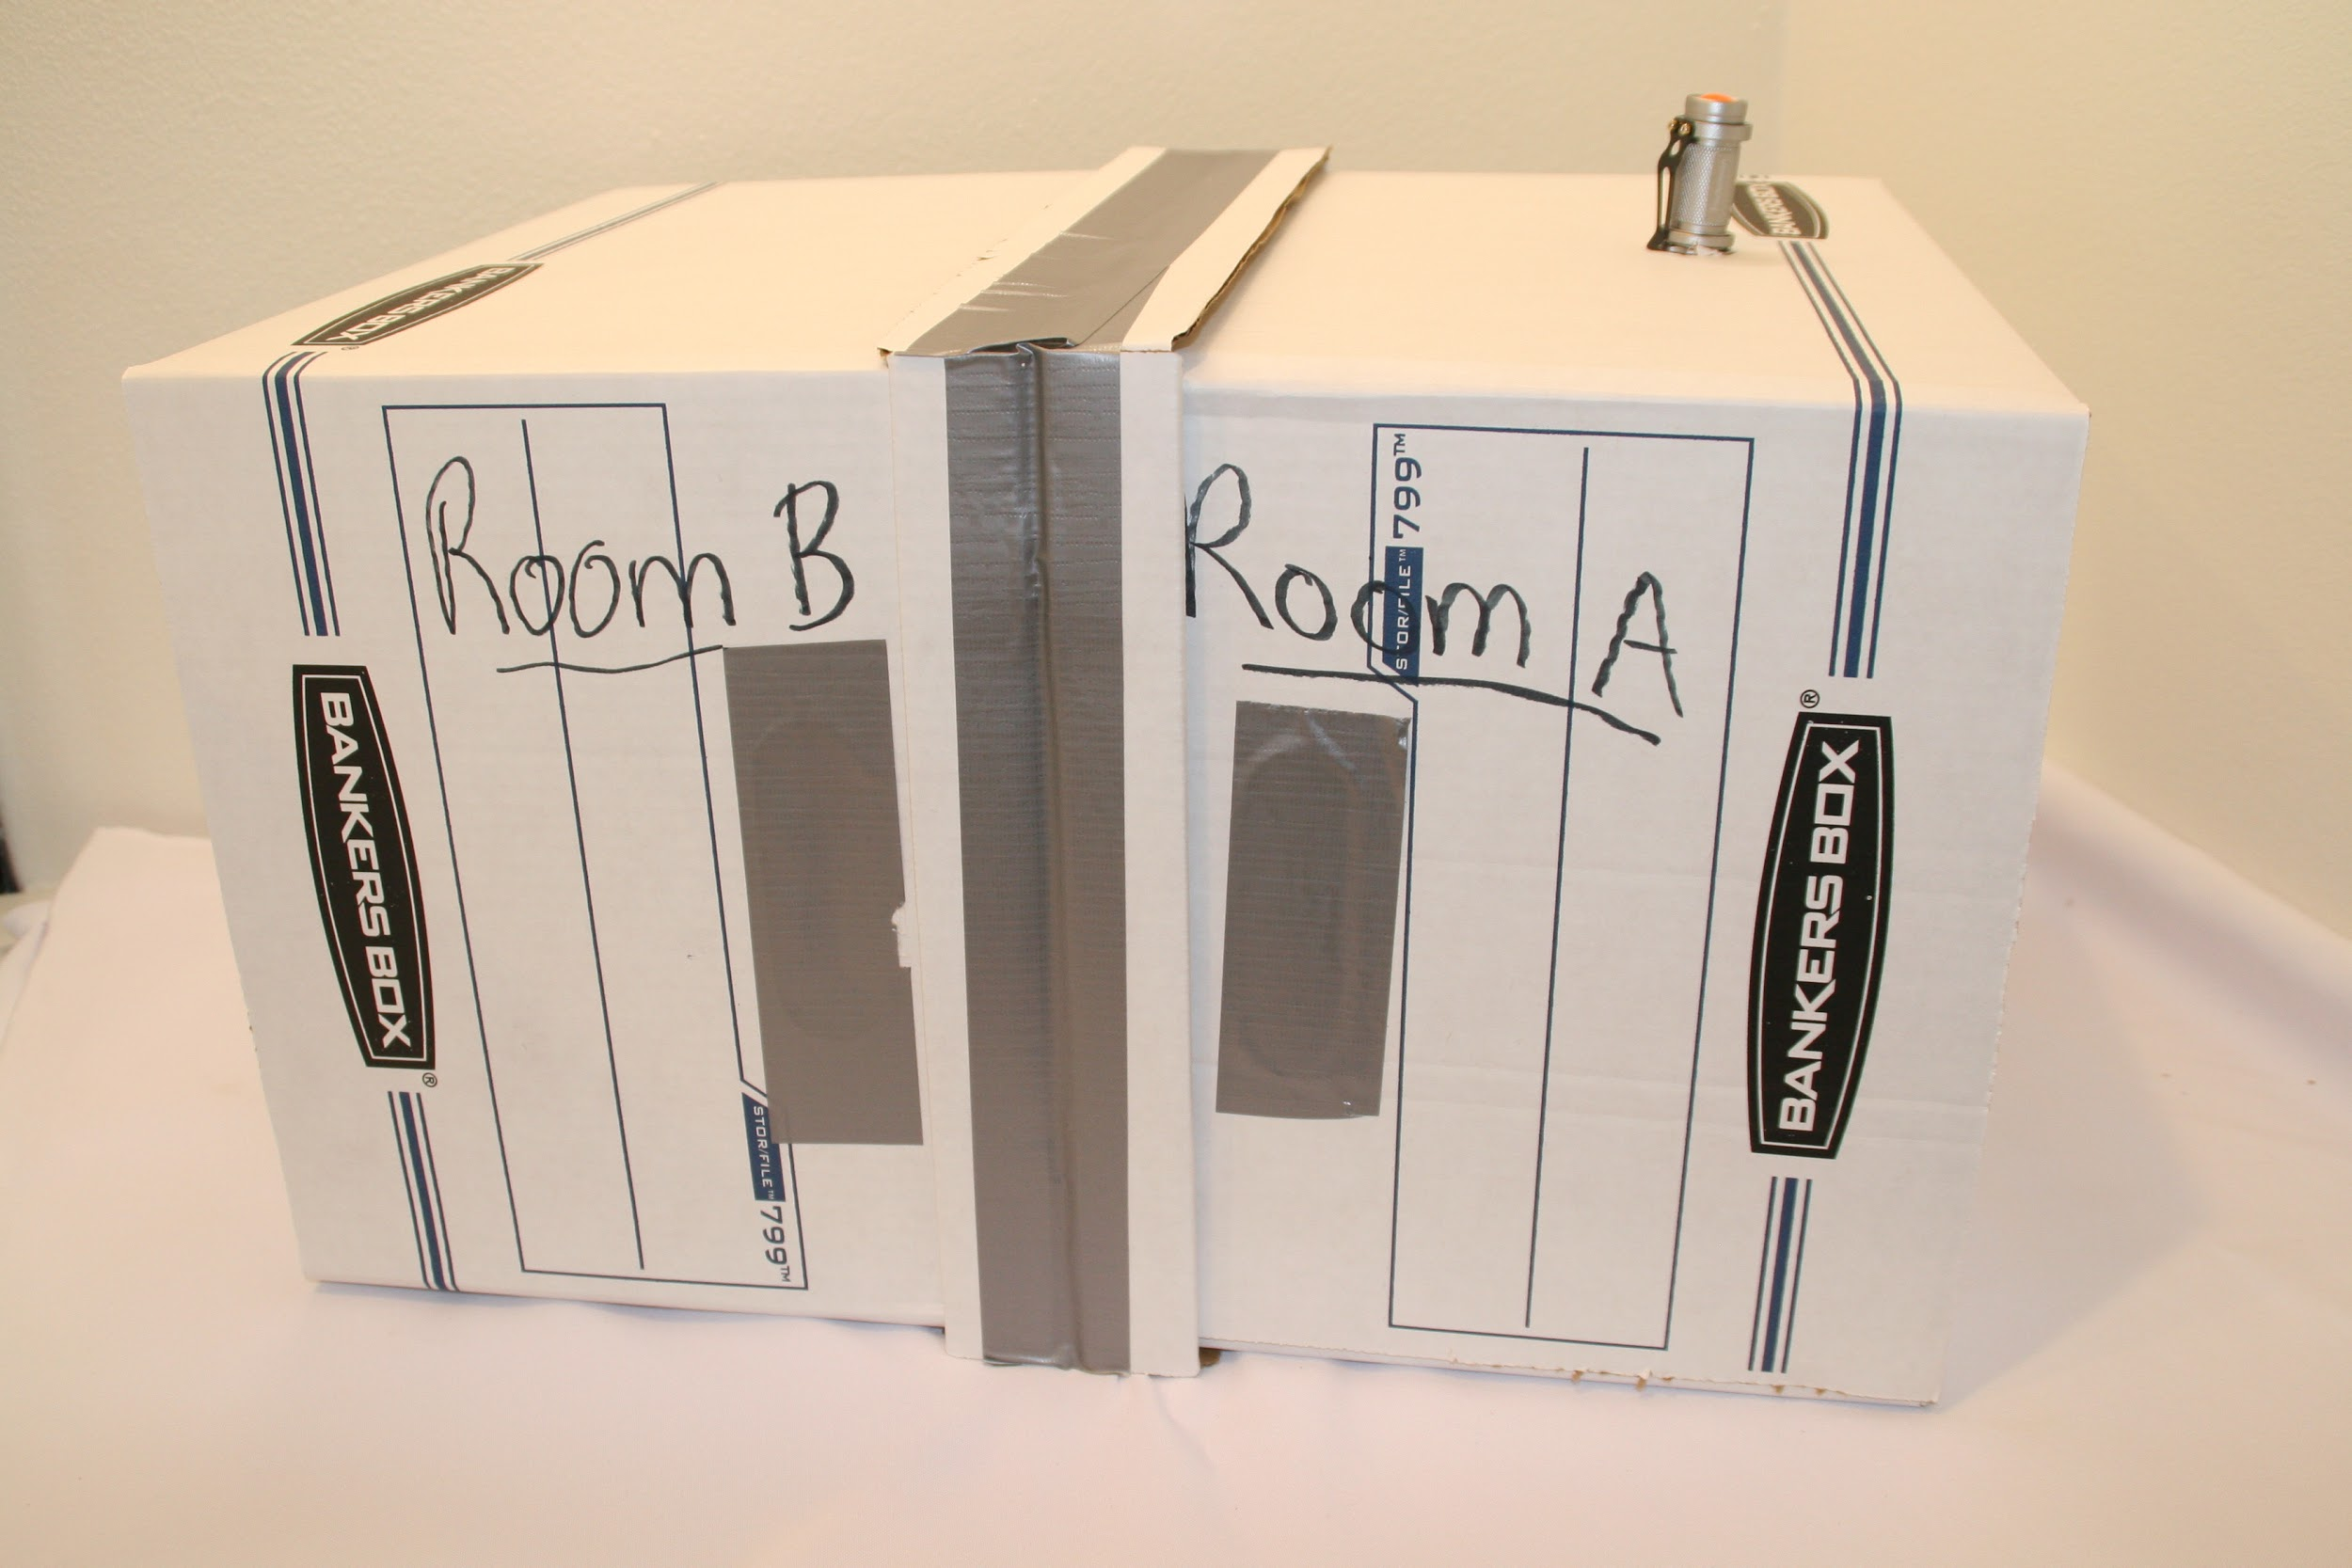
Navigation
Slide H
A scale model is a physical representation of something in the world. It can help us explain phenomena or solve problems.
Where have you seen or used scale models in your life?
Notes:
Elicit students’ experiences with scale models. Show students one of the box models we will use to represent the system in the video. Ask students to share their experiences using scale models to explain something in the real world or to design solutions to problems. Listen for suggestions of models from science class or home, such as these:
replicas of body parts (e.g., skeletons) to explain how a body system functions or moves
solar system models to explain why we have different moon phases
watershed models to explain how water flows downhill within a certain area
rocket models to test how different designs function to support flight
ecosystem models that identify living things within an ecosystem and how they interact
Point out that in every case, the scale model had some features that were helpful for explaining a phenomenon or solving a problem in the real world but also had some limitations. Say, Let’s consider how this scale model is similar to and different from the scene in the real world that we want it to represent.

Slide 9
Mapping the Model to the _______
Slide I
This part of the box model ... | is like this part of the real world ... | because ... | and is not like it because ...
Notes:
Introduce the mapping tool. Present the Mapping the Model to the ________ chart. Explain that this tool will help us to compare the box model to what it represents from the video.
Complete the blank in the chart’s title to orient students to what we are mapping (e.g., Mapping the Model to the One-Way Mirror and Rooms).
Compare the box model parts to the parts in the video. Brainstorm how the parts in the model are similar to and different from the real world shown in the video scene, completing as much as you can in the right two columns of the mapping tool. For answers that students are uncertain about, leave those cells blank and revisit after the Box Model Investigation.

Slide 10
Investigate Using the Box Model
Add the ceiling, walls, and an overhead light to room A.
Peak through the viewing holes for room A and record what you see.
Then peak through the viewing holes for room B and record what you see.
Slide J
Turn on the flashlight for Room A.
Peek through the viewing hole for Room A. Record noticings to your Notice and Wonder chart.
Peek through the viewing hole for Room B. Record noticings.
Turn off the flashlight.
Add wonderings to your chart.
If time allows, remove Room A from the box model.
Locate your Notice and Wonder chart. Draw a line below your last noticing from the video. Add noticings from the Box Model Investigation to your chart.
Mirror-Window Phenomenon
Mirror-Window Diagram
Notice
Wonder
Why do the adults see the music student?
Why does the music student see themself and not the adults?
Video
Box model
Notes:
Set up the science notebook and preview the investigation procedures. Ask students to locate their Notice and Wonder chart in their science notebook. Direct them to draw a line under their last noticing from the video and use the remaining space in the chart to add noticings and wonderings from the Box Model Investigation.
Explain expectations for working in groups and then arrange students in groups, each with a box model at their lab tables.
Observe the box model from the viewing holes. Give groups up to 8 minutes to investigate the box model with the light on in Room A only. Students should look through the viewing holes in both Room A and Room B several times and record their noticings and wonderings.
Remove Room A. If time permits, turn on the classroom lights and prompt students to turn off the flashlight in Room A and carefully remove Room A from the model. With the classroom lights on and a darkened Room B, students should look at the one-way mirror and see themselves - the same experience the music student has. When we enclosed Room A, students had a different perspective of looking at the same thing, but through a viewing hole instead.
Have students carefully add Room A back to the model before returning to their seats.

Slide 11
Slide K
Noticings from the Box Model Investigation
What was similar between what you saw in the video and what you saw in the box model?
What was different?
What new things did you notice in the box model?
Notes:
Introduce the Communicating in Scientific Ways sentence starters. Distribute a copy to each student to tape in their science notebook, or post it in the classroom as a class chart. Explain that these sentence starters are one way to help us better share our thinking during discussion.
Share observations from the box model using sentence starters. Point out the “Observe” sentence starters and note that students can practice using them now to discuss observations. For about 5-7 minutes, use the slide’s prompts to have students share out as a class what they noticed as they used the viewing holes in the box model.
Record new noticings to the class’s Notice and Wonder chart. During the discussion, make certain that students are starting to notice that one side of the model is dark and the other side is light, similar to the video. They are likely connecting that the one-way mirror acts like a mirror on the light side and a window on the dark side.
Return to the Mapping the Model to the _____ chart to complete any comparisons that students were uncertain about.

Slide 12
Limitations of the Box Model
Slide L
If we use this box model to test ideas about the one-way mirror phenomenon, what differences between the box model and the real world shown in the video could be important to keep in mind?
Notes:
Evaluate limitations of the box model. Take a couple of minutes to reflect on differences between the box model and the real world it represents.
Listen for suggestions such as these:
Eyes outside the box looking through the viewing hole is not like the music student seeing themself.
The color of the inside of the box is different from the colors on the wall.
The flashlight isn’t quite the same as the light in the room.

Slide 13
Slide M
Exit Ticket
Look at your Notice and Wonder chart and your diagram.
What is one idea you want to bring to our class discussion next time to help us explain the phenomenon?
Notes:
Have students complete an exit ticket. Distribute an index card to each student. Ask students to scan their Notice and Wonder chart and their initial diagram to see what ideas they want to bring to the next class discussion. Have students write their name and at least one idea on the exit ticket. Collect the exit tickets before students leave. Use them to prepare for the Consensus Discussion in the next class period.

