Slide 1
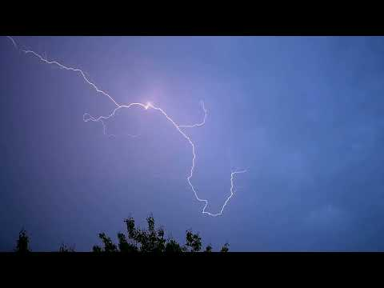
Examine Lightning Strikes
Slide A
With your class
What is happening in this video?
Where is the lightning going from and to?
Kdv888 on Pixabay
Notes:
Introduce the new unit. Say, Last unit, we figured out a lot about how human activity causes particle-level changes that affect all parts of the Earth system, including people. This unit, we will use the same structures and strategies to figure out what is happening with a new phenomenon.
Introduce lightning as a new phenomenon to explore. Say, The phenomenon that we will explore in this unit is one you have probably all witnessed yourselves, but I have a video here to watch so we can all have an example to be thinking about.
Play the video linked on slide A and found at https://www.youtube.com/watch?v=tgwEHUiGgJs&list=PLSLDxqPb5NQl9M_K3kLMVMzVM776FB-YF&index=1 which shows a series of lightning strikes in real time. You may want to play the video a second time. Ask students to describe what is happening in the video--specifically, where the lightning is going from and to.
Here are some sample student responses:
There’s flashing and there are bolts/strikes.
Some strikes/bolts are brighter than others.
It’s all across the sky and going in several directions--sometimes to the ground, sometimes maybe not.
The bolts branch out (from larger main “lines?” to smaller ones).
Briefly elicit ideas about how we could better see what is happening. Listen for students to suggest slowing the video down.
Motivate changing the timescale of the lightning. Point out that students are starting to notice patterns in what is happening with the lightning in this video. Ask, If we change the timescale--if we can slow the timescale down in the video--how would that help us notice patterns about the lightning?
See the prompts in the teacher guide for support.

Slide 2
Slide B
Examine Lightning Strikes
In your notebook
Make a chart to record what you notice and wonder about what you see in the slow-motion videos of lightning.
Notice
Wonder
Dr. Marcelo Saba, National Institute for Space Research
Notes:
Watch videos of lightning in slow motion. Display slide B. Direct students to set up a Notice and Wonder chart in their science notebooks. They should record their thoughts as they watch the following videos. Instruct students to focus on one video at a time, and to watch both multiple times.
First lightning strike in slow motion: https://www.weather.gov/images/safety/Animation/Animation_16a.gif

Slide 3
Slide C
Examine Lightning Strikes
In your notebook
Continue recording in your Notice and Wonder chart.
Notice
Wonder
Be prepared to share your ideas with the class.
Dr. Marcelo Saba, National Institute for Space Research
Notes:
Display slide C and show the second video.
Second lightning strike in slow motion: https://www.weather.gov/images/safety/Animation/Animation_17a.gif
You will likely want to play each of the videos multiple times to allow students more opportunities to record their observations. Observations students may highlight in these videos include:
Something seems to be trailing or falling down the sky before the brighter burst of lightning flashes.
The bright burst of lightning seems to flash from bottom to top, not top to bottom.
Facilitate an Initial Ideas Discussion. Invite students to share aloud with the class what they noticed and wondered.
See the prompts in the teacher guide for support.
Draw on excitement about the phenomenon to motivate sharing of stories. Use student language about lightning to emphasize the ways in which it evokes memories and experiences. Say, Whether we have seen lightning in our area a lot or not, we probably have some interesting thoughts about what lightning is or what it means.

Slide 4
What stories have you heard about lightning?
Slide D
Turn and Talk
What do you know about lightning?
What stories, family history, or mythology have you heard about lightning?
How do these stories help us make sense of lightning and its role in the world around us?
Be prepared to share your ideas with the class.
Notes:
Elicit students’ lightning stories. Display slide D. Give students one minute to turn and talk with a partner or table group. Then ask for several volunteers to share their own stories or stories from their partner.
See the prompts in the teacher guide for support.
Read and view stories about lightning. Say that people throughout the world and throughout history have told stories to try to understand what lightning is and how it happens. Point out that even though people do not always use these terms, many of the stories involve matter and energy playing special roles, just like they did throughout our first unit.

Slide 5
Read Stories About Lightning
Slide E
With your group
Each group member should read or view one of these stories:
Navajo Oyo Mythology Inventors
Be prepared to share with your group:
How does the story explain lightning?
In what ways are matter or energy part of the story?
Notes:
Prepare to read. Display slide E. Divide the class into groups of four and ensure that a member of each group is assigned one of four readings or videos:
Lightning Stories: Mythology
Lightning Stories: Inventors
https://youtu.be/QhqVFakF0N0 (Sango the Oyo King)
https://www.youtube.com/watch?v=zfhbMTGaecc (Navajo Beliefs on Lightning)
Tell students that each group member will be responsible for reading and explaining one story to their group. Give students five minutes to read their individual story and record their answers to the two questions on the slide, then give groups an additional three minutes for students to share with their group.

Slide 6
Read Stories About Lightning
Slide F
With your group
What similarities did you notice between the stories?
What differences did you notice?
Be prepared to share your ideas with the class.
Notes:
Discuss similarities and differences. Display slide F. Ask groups to discuss the similarities and differences between the stories. Then ask two volunteers to share similarities and two more to share differences with the class.
See the prompts in the teacher guide for support.
Celebrate students’ observations and the variety of stories they just read. Say, Lightning plays an important role in many places and cultures, but it does not occur evenly everywhere on Earth or throughout the year. We will look at some data to help us identify patterns that could help explain why lightning occurs only sometimes.

Slide 7
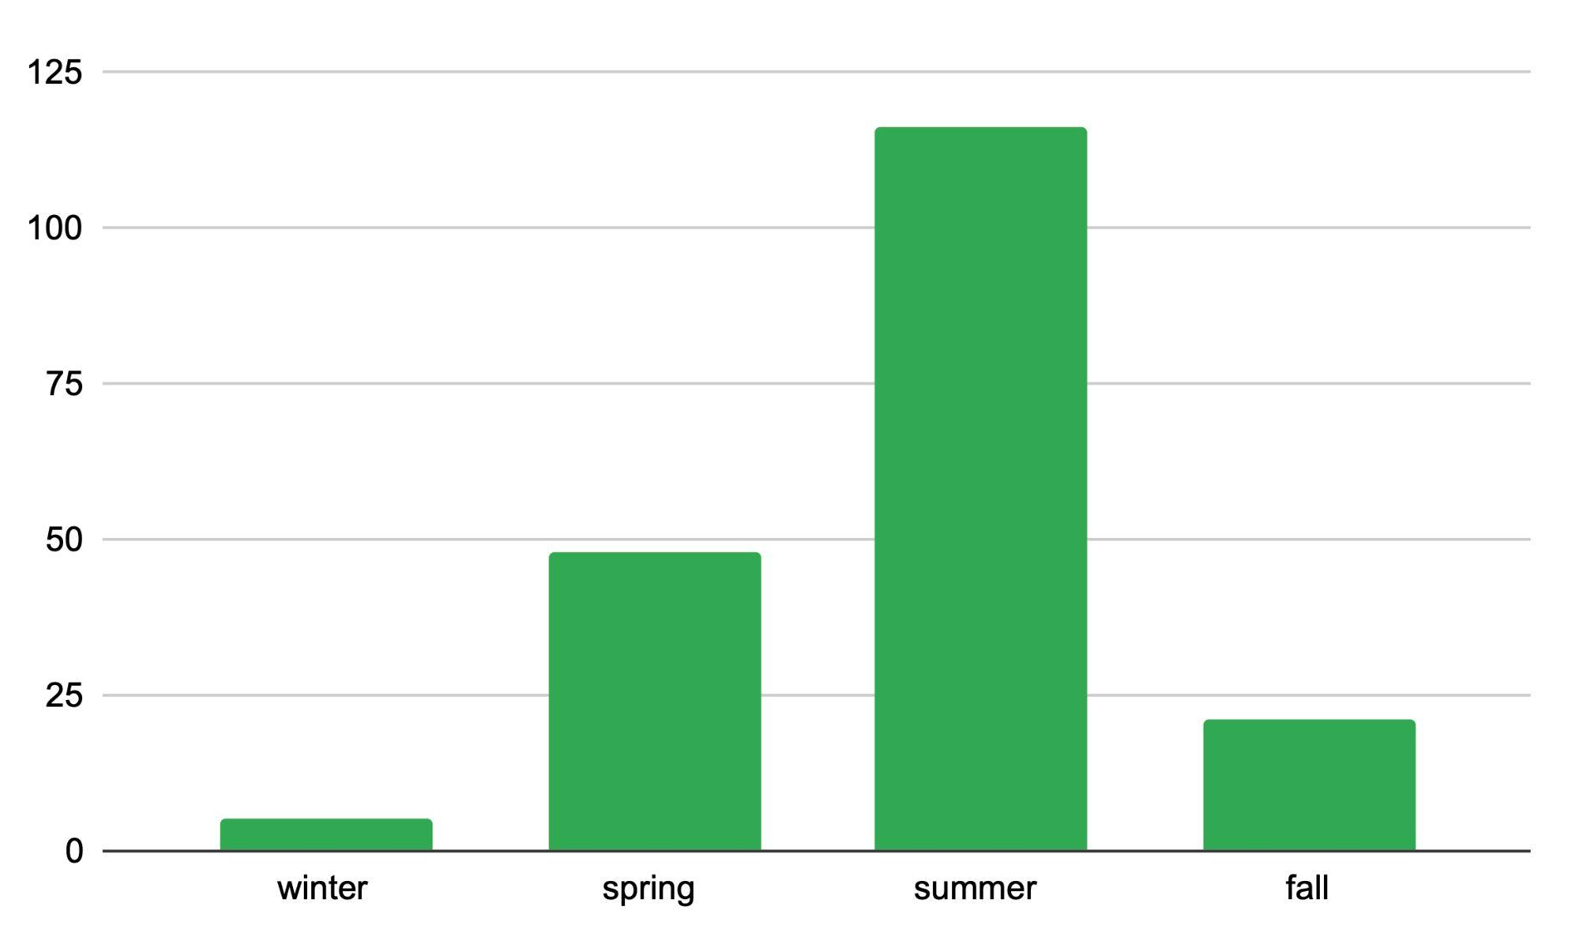
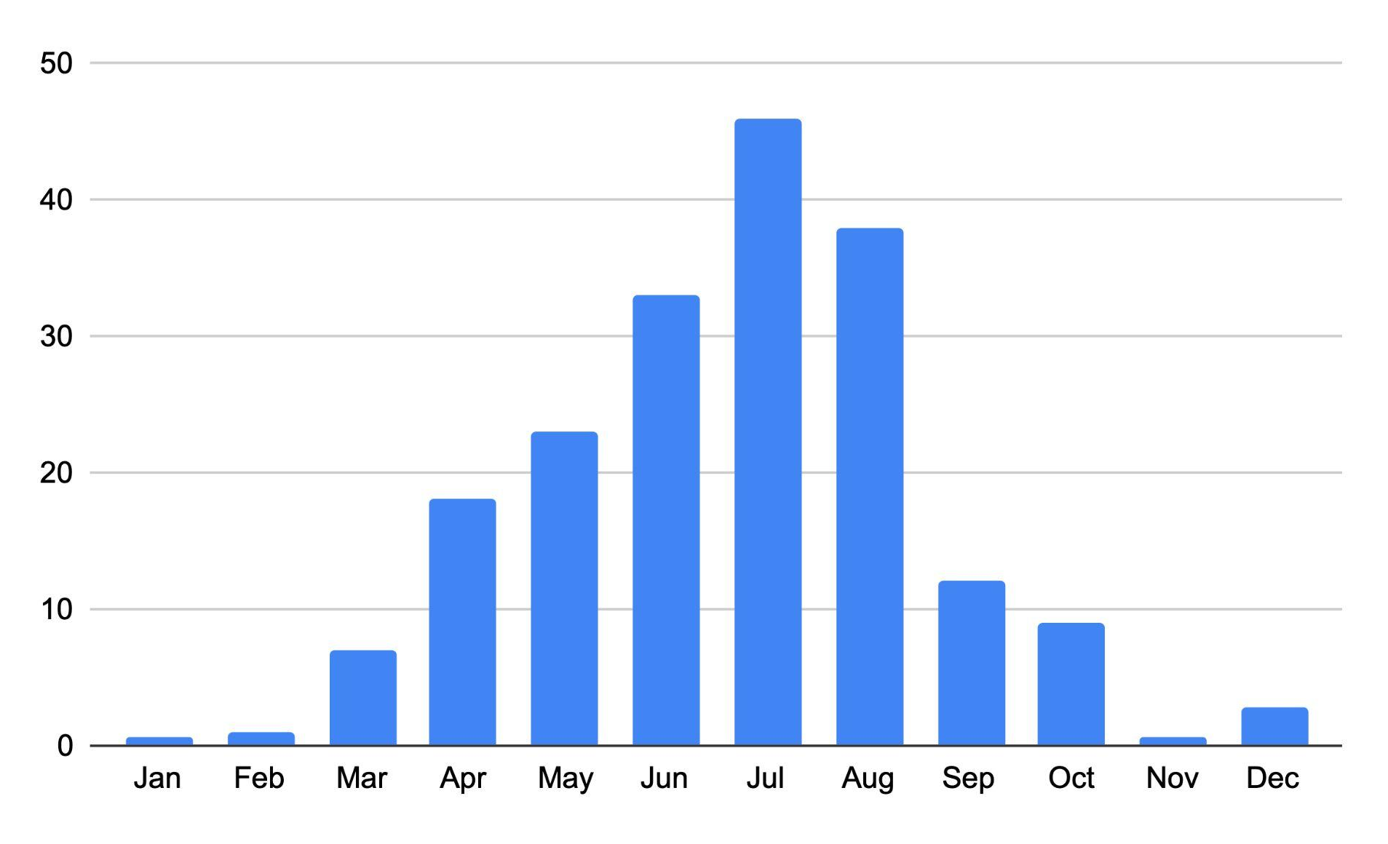
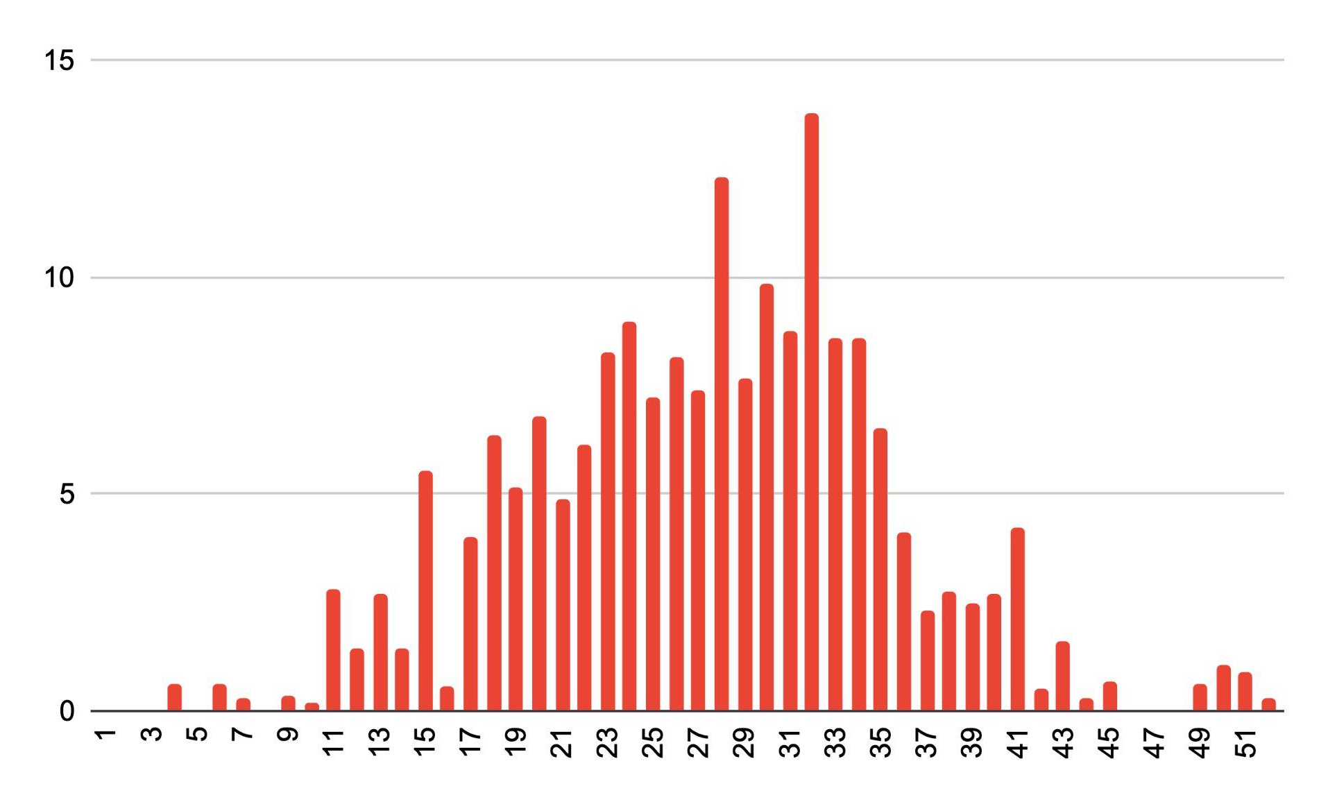
Slide G
When does lightning occur?
Annual Lightning Flashes for the United States
millions of flashes
Seasons
Months
Weeks of the Year
What do each of these graphs show?
What patterns do you notice across the graphs?
What questions do you have about these data?
Turn and Talk
Be prepared to share your ideas with the class.
Data source: Vaisala. (n.d.). 2021 Annual lightning report. Retrieved March 24, 2022, from https://www.vaisala.com/en/annual-lightning-report
Notes:
Analyze data in graphs of lightning flashes versus time. Display slide G which includes the graphs also shown below. Direct students to draw a horizontal line under the text they already have in their Notice and Wonder chart to indicate that we are now gathering ideas from a different source. Prompt students to record their questions and ideas about these graphs under this line. Direct students to turn and talk with a neighbor for a moment about the following questions:
What do each of these graphs show?
What patterns do you notice across the three graphs?
What questions do you have about these data?
If students do not pick up on the different timescales on the three graphs, ask them to focus on the x-axes, or ask them how the timescales are different.
After this brief partner talk, have students share their ideas with the whole class. Establish that lightning occurs much more frequently in the summer months than in other times of the year. Record observations on the chart paper titled “Patterns We Notice About Lightning.”
Leverage wonderings like, “Where are these data from? Does lightning follow this pattern everywhere?”, to motivate looking at location data next.

Slide 8
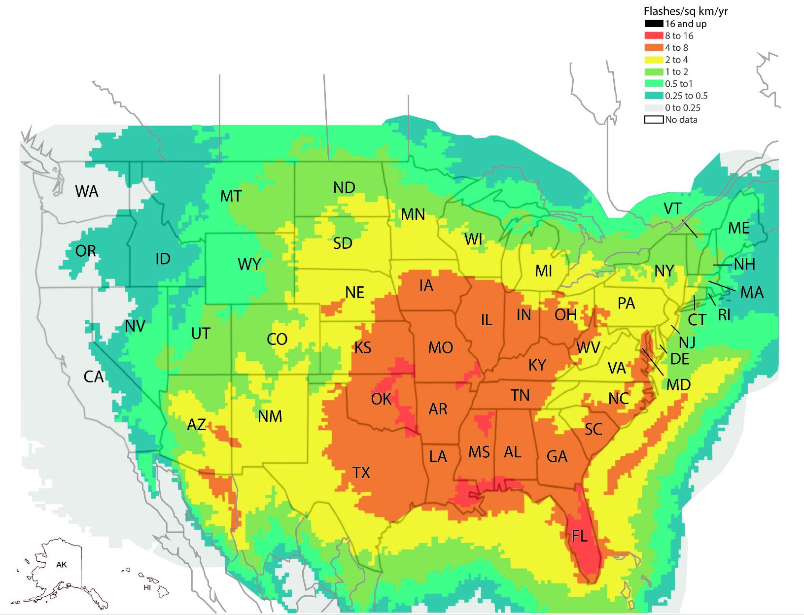
Slide H
Where does lightning occur in the U.S.?
With your group
Analyze the data from this map.
Add to your Notice and Wonder chart.
Data Source: Holle, Ronald. (2014). Diurnal Variations of NLDN-Reported Cloud-to-Ground Lightning in the United States. Monthly Weather Review. 142. 10.1175/MWR-D-13-00121.1. Modified from Dyer and mapchart.net..
Notes:
Analyze a map of lightning strike occurrences in the continental United States. Display slide H. Orient students to the flash density map, finding your home state (if shown) and discussing what the colors on the key represent (flashes per square kilometer per year).
Direct students to work with a group to record what they notice and wonder in their notebooks, again under another horizontal line to indicate a new data source. Give students about three minutes. If you wish, share US Lightning Data so that students can more easily read the map and access specific numerical data for each state, including Hawaii, Alaska, and the District of Columbia.
Have a few students share their observations. Record these on “Patterns We Notice About Lightning.” Listen for these ideas in particular:
Florida, Louisiana, those bits of Alabama and Mississippi that are along the Gulf of Mexico, and parts of the Great Plains had the most lightning flashes per square kilometer per year.
Places that are warmer, less dry, or lower tend to have more lightning, but there are some exceptions to these patterns.
The West Coast seems to have very little lightning even though it’s right on the ocean.
Say, We gathered these ideas about lightning here in the United States. Let’s look next at lightning occurrences around the world and see what patterns we notice.

Slide 9
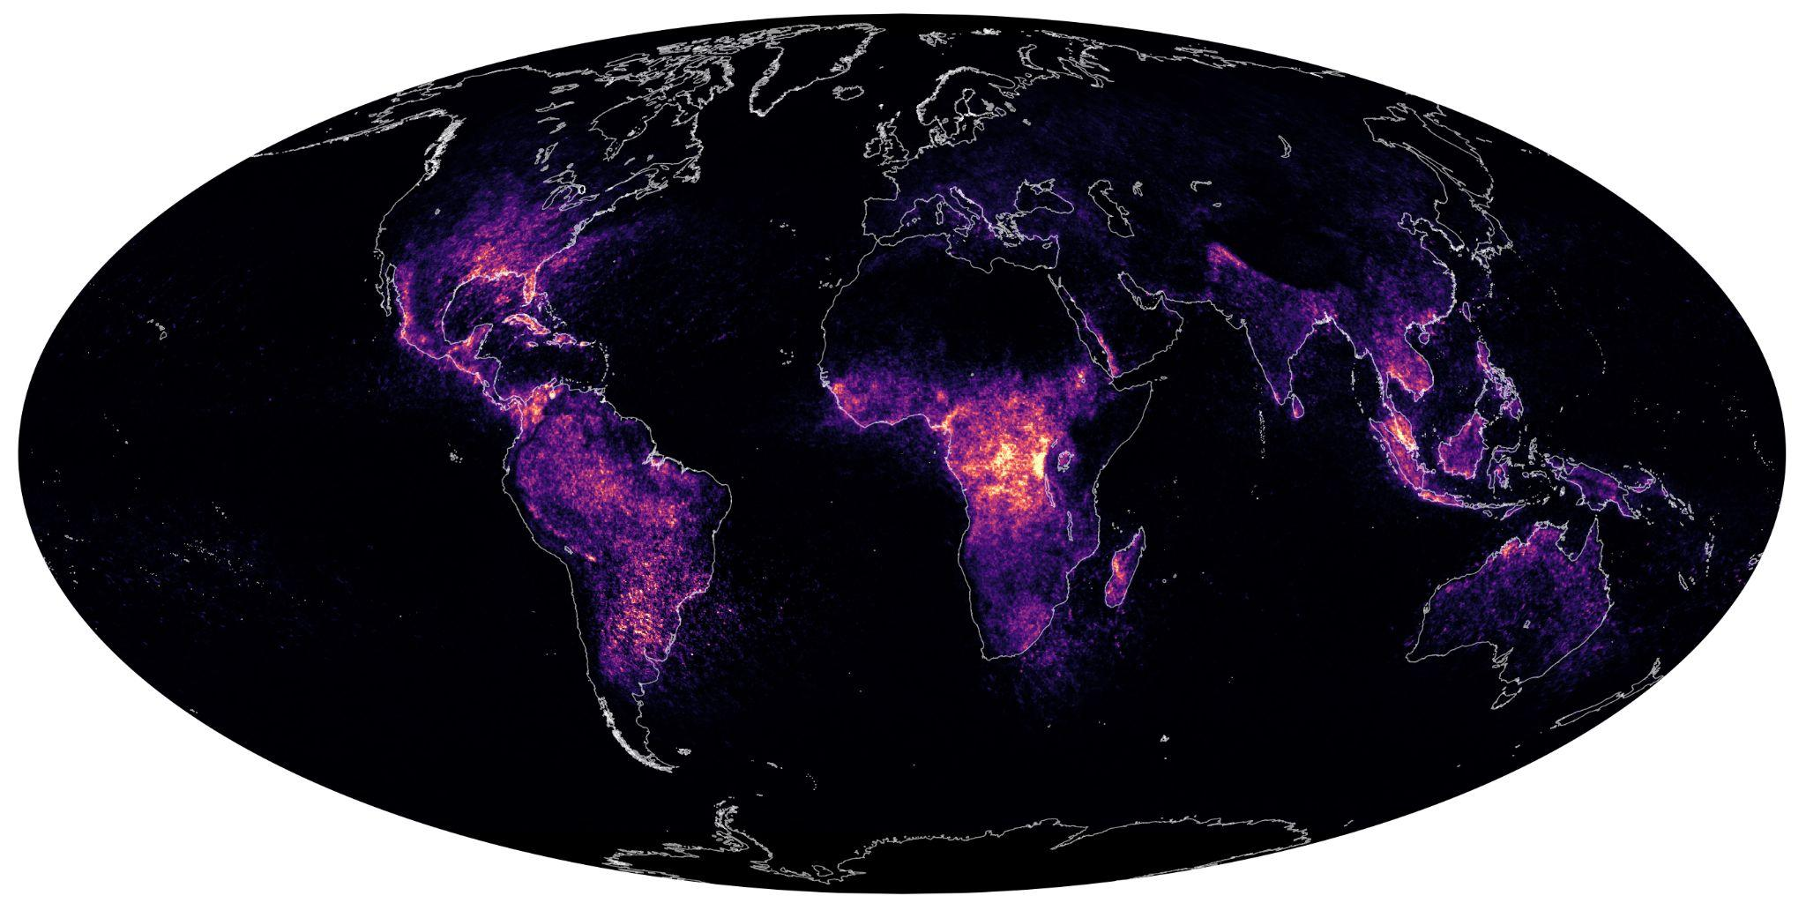
Slide I
Where does lightning occur in the world?
Gobi Desert
Arabian Desert
Sahara Desert
Atacama Desert
NASA, Lauren Dauphin
Notes:
Analyze a world map of lightning. Display slide I. Orient students to the color scale along the bottom of the map. Say, We already have some ideas about when and where lightning happens from looking at US data, but what about the rest of the world? You may want to explain to students that these data were collected by satellite sensors from 1995 to 2020. Use the questions below to help target students’ observations.
See the prompts in the teacher guide for support.
Navigate to exploring data about the damage caused by lightning. You might refer to a question students have already raised about the damage lightning can cause, or say something like, Now that we are starting to get a sense of where and when lightning happens most often, let’s look at some of its impacts.

Slide 10
Slide J
Prepare to Examine Impacts of Lightning
With your class
How could it help us to consider lightning damage data?
How can we support each other as we discuss information that could be stressful to think about?
Notes:
Prepare to discuss damage caused by lightning. Display slide J. Tell students that the data we will look at next specifies how lightning causes damage to people’s homes and lives, and it is okay to feel concerned by this kind of information. Use the prompts on the slide to consider why it is important to look at these difficult data.
See the prompts in the teacher guide for support.
Summarize by saying something like, Lightning can be scary because it can cause harm. One thing we as scientists can do in this class is examine data and use that information to figure out how we can be safer from lightning.
Tell students to jot down any questions they have about these statistics on the “wonder” side of the chart in their science notebooks, under another horizontal line for this new data source.

Slide 11
Slide K
Examine Lightning Injury Data
With your class
There are an estimated 400 lightning-related injuries each year in the United States.¹
Of those people injured by lightning, up to 74% may have a permanent disability.¹
Lightning is responsible for about 240,000 injuries per year worldwide.²
1. Data source: Jensen J.D., Thurman J., & Vincent A.L. (2022, February, 6). Lightning injuries. StatPearls. https://www.ncbi.nlm.nih.gov/books/NBK441920/
2. Data source: Global Hydrology Research Center. (n.d.). Lightning primer (italicize). National Aeronautics and Space Administration. https://ghrc.nsstc.nasa.gov/lightning/lightning_primer.html
Notes:
Share the lightning injury information on slide K:
There are an estimated 400 lightning-related injuries each year in the United States.
Of those people injured by lightning, up to 74% may have a permanent disability.
Lightning is responsible for about 240,000 injuries per year worldwide.
Again, prompt students to record what they notice and wonder.
Predict where lightning fatalities are highest. Direct students to record a prediction in their science notebooks to answer the question, Where in the U.S. would you predict to see the most fatalities from lightning? Why?
Invite students to share their predictions with the class and explain why they predicted that more fatalities would occur in those locations. Accept all student predictions.
Sample student reasonings:
The areas that had the highest lightning flash density (i.e., Florida, along the Gulf Coast, in the midwestern Plains) would have the most fatalities from lightning.
Areas that are warmer would have more fatalities from lightning, since we think lightning is correlated to warm temperatures (and maybe people are more likely to be outside, unsheltered when/where it’s warm outside).

Slide 12
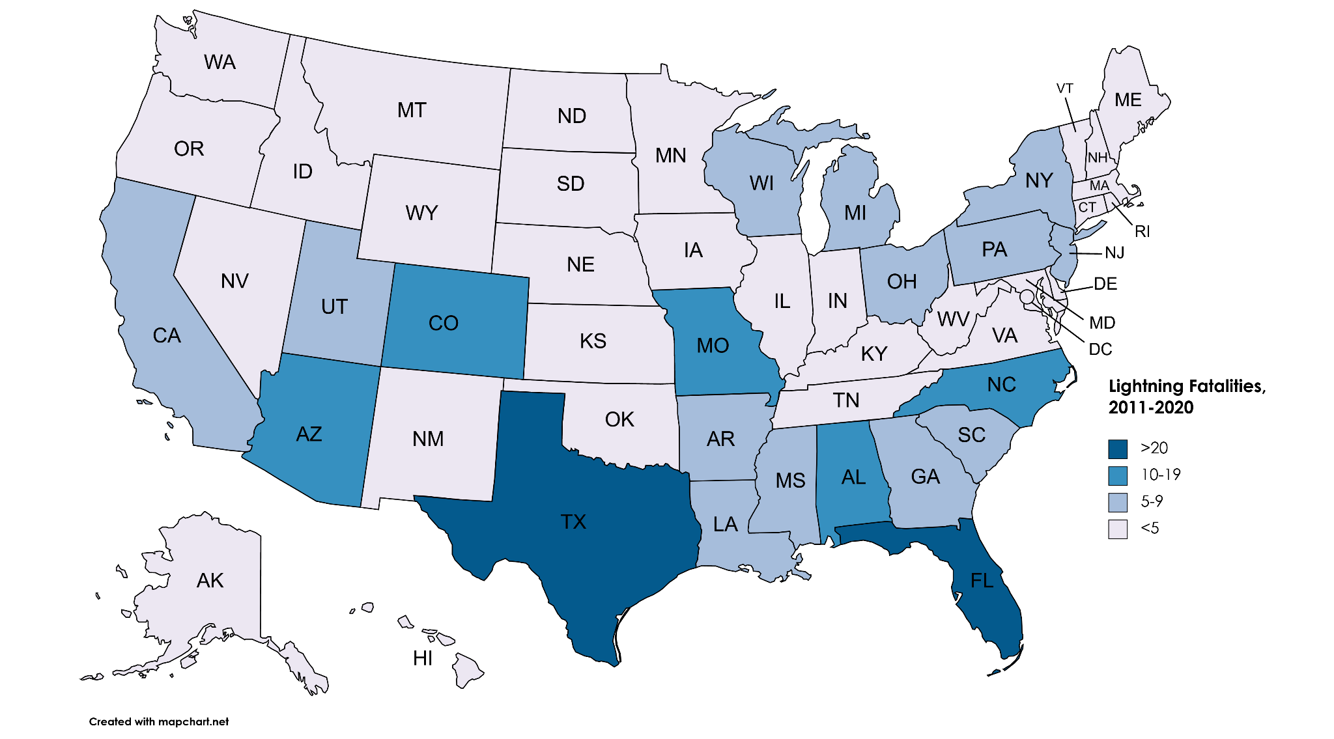
Slide L
Examine Lightning Fatality Data
Data Source: Lightning Safety Council. (2023)
Created with mapchart.net.
Notes:
Analyze a map of lightning fatalities by state. Display slide L. Tell students to silently examine the map, compare its data to their predictions, and record any additional noticings or wonderings in their science notebooks under a final horizontal line for this last data source. Give students a minute or two to complete this step.
See the prompts in the teacher guide for support.

Slide 13
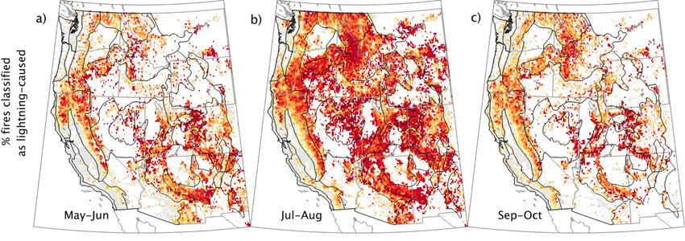
Slide M (optional)
Examine Lightning-Caused Wildfires
1992–2013 aggregated to a 1/8th degree grid.
John Abatzoglou, Crystal Kolden, Jennifer Balch, Bethany Bradley, CCBY 3.0
Notes:
Extension opportunity: Optional slide M includes maps of wildfires classified as lightning-caused. If your students have mentioned lightning’s relationship with wildfires or if wildfires have a significant local connection for you, you might choose to include this data in your discussion. You will likely need to orient students to what the maps show, as they are somewhat complex.
If your students experienced OpenSciEd Unit B.2: What causes fires in ecosystems to burn and how should we manage them? (Fires Unit), they will bring in a wealth of knowledge about wildfires: what causes them, the effects they can have, and how human activities have impacted fire systems. These students will know the benefits wildfires provide to ecosystems and that they are not necessarily an example of damage done by lightning.
The goal with the maps in this extension activity is to acknowledge that wildfires can be caused by lightning (among other causes) and to elicit students’ thinking and connections to the impacts of lightning. In this unit, students will not investigate how lightning causes fires, why some areas are more susceptible to wildfires, or the damage done by fires. Suggest that students look for similarities and differences between these three maps and the other maps and data students examined on previous slides. Give students a few minutes to work with their groups.

Slide 14
Slide N
Identify Patterns About Lightning
With your class
Review and add to the record of the patterns we have found across data sets.
What factors seem to influence where or when lightning occurs?
How did looking at different data and scales of data help us?
NASA, Lauren Dauphin
Notes:
Review the “Patterns We Notice About Lightning” list as a whole class. Display slide N. Make any additions or edits to the “Patterns We Notice About Lightning” poster by leading a Building Understandings Discussion about these patterns. Be explicit with students about your role as a facilitator in this particular discussion type.
See the prompts in the teacher guide for support.
Summarize the patterns students point out. Say, We will continue digging into what causes lightning next time we are together.

Slide 15
Slide O
Navigate
With your class
What did we figure out about lightning last class?
What were we wondering about, or what questions did the data raise for us?
Notes:
Revisit what we figured out last class about lightning. Display slide O. Have a brief discussion to help students remember what they figured out last class.
See the prompts in the teacher guide for support.
Explain that we will work more with these ideas today by developing initial models for what causes lightning, but before we go there, we should review what we know about scientific models and the practice of modeling.

Slide 16
Slide P
Review Model Development
With your class
Why or how do scientists (like us) use models when thinking about phenomena like lightning?
Why is it important to include:
components?
relationships or interactions?
mechanisms?
Notes:
Review the elements of a model. Display slide P. Use the prompts to discuss the purpose and elements of scientific models. An alternate task follows this activity if students are not able to quickly address these prompts.
See the prompts in the teacher guide for support.

Slide 17
Slide Q (optional)
Review Model Development
With your class
Before we develop our models to explain lightning, let's review what modeling entails with a familiar example: How do you move a soccer ball with your foot? What are the:
components?
relationships or interactions?
mechanisms?
Notes:
Use a concrete example to think about modeling. Display slide Q. Tell students, Models should always be in service of answering a question or explaining a phenomenon. As an example of modeling, ask student volunteers to work with you to construct a model to explain: How do you move a soccer ball with your foot? Invite students to call out ideas to help you draw and label this model on a whiteboard as you identify and discuss its elements together as a class. Sample student responses are shown in the table below.
See the prompts in the teacher guide for support.

Slide 18
Slide R
Develop an Initial Model
With a partner
Brainstorm components to include in your model to answer the question, What causes lightning to strike at a particular place and time?
On your own
Develop your model
Be sure to include and show relationships between the components you brainstormed.
Notes:
Reintroduce the element of the Anchoring Phenomenon Routine: Attempting to make sense. Remind students that in Polar Ice Unit, we tried to make sense of the phenomenon by developing initial models. Say, We do not have to worry about right or wrong answers in these models, as the goal is for us to get ideas on the table. We can return to our models throughout the unit as we figure out the things that we are currently uncertain about.
Brainstorm model components with a partner. Display slide R. Distribute Initial Model. Tell students they do not need to write their names on this yet. Set a timer for two minutes and direct students to talk with a partner to generate ideas about what components they will include in their models to answer the question, What causes lightning to strike at a particular place and time? They can list their ideas at the top of the handout.
Individually develop initial models. Direct students to work on their own to use the components they listed to develop their initial model. Guide them to use words and/or drawings and point out the “zoom in” space. Remind students that we thought a lot about how to explain phenomena at the particle level in the last unit, so we want to continue using that scale of thinking about the different parts of a system to make sense of this phenomenon, too.
Also remind students to complete the explanation part of the handout. They should refer to the “Patterns We Notice About Lightning” poster from day 1 and choose one of those ideas to explain how that factor impacts differences in lightning.
Give students about eight minutes to work on their models. As they work, circulate and ask clarifying questions about parts of models that are blank or unclear. Encourage students to add labels, descriptions, or text where needed.

Slide 19
Slide S
What is lightning?
Turn and Talk
Is lightning energy, or is lightning matter?
What evidence do you have for either?
How does answering these questions help us figure out what causes lightning?
Be prepared to share your ideas with the class.
Notes:
Think about what lightning is. Display slide S. Give students one minute to turn and talk about whether they think lightning is energy or matter, and what evidence they have for either. Then ask for volunteers to share their ideas with the class.
See the prompts in the teacher guide for support.

Slide 20
Slide T
Revisit the Initial Model
With a partner
Brainstorm how energy and matter are involved in a lightning strike.
On your own
On your model:
Show two places where particle-level changes are happening in the lightning system.
Use energy transfer models to show two energy transfers that are occurring.
Notes:
Revise models to include matter and energy. Display slide T. Say, Now that we have thought about what lightning is, let’s see if we can revise our models to show where we think matter and energy are and what they are doing. Tell students to work with a partner to think about how to specifically model the matter changes and energy transfer involved. Suggest that students spend two minutes individually revising their models to include matter, and another two minutes revising them to include energy. Ensure that students are not just adding these components, but drawing relationships to other parts of the system.

Slide 21
Slide U
Revisit Our Community Agreements
With your class
Think back to the discussion we had to develop our initial models and pull out your notes. Which of our agreements did we do well, and which do we need to work on?
Mark one agreement you think we have done well with a green sticky note.
Mark one agreement you think we need to improve on with a yellow sticky note.
Notes:
Revisit our Community Agreements. Display slide U. Say, Think about what we have done the last two days of class: looking at lightning data, developing our initial models, puzzling over what we think lightning is. Which of our Community Agreements did we do well with, and which do we need to work on?
Refer to the Community Agreements the class created during OpenSciEd Unit C.1: How can we slow the flow of energy on Earth to protect vulnerable coastal communities? (Polar Ice Unit). If this is a poster in the room, give students a moment to look over the poster. If you have a digital copy of the Community Agreements, add them to slide U. Direct students to mark one agreement they think we have done well with with a green sticky note or dot, and an agreement they think we need to develop more with a yellow sticky note or dot.
See the example in the Teacher Guide of how this might look.
Analyze the patterns in the green and yellow sticky notes.
See the prompts in the teacher guide for support.

Slide 22
Slide V
Have a Gallery Walk
In your notebook
Make a chart in your science notebook to record similarities and differences between models.
On your own
Post your model in the room.
Silently circulate to view others’ models and record the similarities and differences you notice.
Similarities
Differences
Notes:
Conduct a gallery walk to compare initial models. Display slide V. Direct students to make a chart in their science notebooks where they will record similarities and differences they notice among the models during the gallery walk.
Then, direct students to post their models around the room. At this point, we are focusing only on the model side of the handout--we will not compare explanations about the impacts of different factors from the reverse side. Encourage students to pay particular attention to how matter and energy are represented in the models, and what role matter and energy play in lightning strikes.
Give students three to four minutes to silently circulate around the room to view classmates’ models and record the similarities and differences they notice.

Slide 23
Slide W
Develop an Initial Consensus Model
Scientists Circle
Start building an initial consensus model to help explain the question:
What causes lightning to strike at a particular place and time?
Notes:
Begin to develop an initial consensus model. Gather students in a Scientists Circle. Display slide W and remind students of your classroom protocol for sitting or standing in a circle where everyone can be seen and heard. Direct students to bring their science notebooks and Initial Model with them to the circle.
Develop an initial consensus model for what causes lightning. Tell students that the goal of this discussion is to capture areas of agreement and disagreement about our individual initial models. Knowing where we agree and disagree will help us establish what we need to figure out about what causes lightning and possibly how to prevent injuries and damage from it. Be explicit with students about the shift of your role in this discussion type. See the Consensus Discussion callout for more guidance.
Facilitate a Consensus Discussion while you record the class’s initial consensus model on a piece of chart paper or shared digital space titled, “What causes lightning to strike at a particular place and time?” It is okay if you do not finish the discussion, as you will have more time on day 3.
See the prompts in the teacher guide for support.
See the example initial consensus model in the Teacher Guide, keeping in mind that the one you and your class develop may look different.

Slide 24
Slide X
Choose a Focal Community Agreement
Individual Think Time
Choose one of our Community Agreements that you want to focus on for yourself as we share our questions today.
With a partner
Tell your partner why you chose that agreement and how you plan to work on it.
Notes:
Choose focal Community Agreements for today. Point out to students that we want to make sure we continue to follow our Community Agreements that we reviewed yesterday. Direct students’ attention to the class-created Community Agreements poster or digital copy. Display slide X. Have students individually choose an agreement they will focus on today. Then, have students tell a partner why they chose that agreement and how they plan to work on it.

Slide 25
Slide Y
Develop the Initial Consensus Model
Scientists Circle
Finish building an initial consensus model to help explain the question:
What causes lightning to strike at a particular place and time?
Notes:
Gather in a Scientists Circle. Say, We started to create our initial consensus model last class but we did not have time to finish, so let’s do that now. Display slide Y and remind students of your classroom protocol for sitting or standing in a circle where everyone can be seen and heard. Direct students to bring their science notebooks and handouts with them to the circle.
Continue to develop the initial consensus model for what causes lightning. Remind students that the goal of this discussion is to capture areas of agreement and disagreement about our individual initial models. Knowing where we agree and disagree will help us establish what we need to figure out about what causes lightning and possibly how to prevent injuries and damage from it. See the above Key Ideas and Consensus Discussion callouts for guidance on this discussion.
When you are done, collect students’ models so that you can provide initial three-dimensional feedback to students.

Slide 26
Slide Z
Brainstorm Related Experiences
Turn and Talk
When and where have you experienced (or seen someone experiencing):
lightning?
something similar to lightning?
What signals do you use to decide to protect yourself against a storm? How does where you are determine how you stay safe?
Be prepared to share your ideas with the class.
Notes:
Brainstorm related phenomena. Say, Like we did during our first unit, let’s take some time to think of similar or related phenomena--other experiences we have had or things we have seen that could be related to lightning in some way. These ideas or experiences we have from our lives can help us make progress on figuring out more about lightning and lightning safety.
Brainstorm examples of related phenomena and safety precautions. Display slide Z. Say, We have already been mentioning some of our personal experiences with lightning and connected ideas, but now we want to take time to think about and record these specific ideas that we can use in this unit.
Have students turn and talk with a partner about the prompts on the slide, also listed below:
When and where have you experienced (or seen someone experiencing):
lightning?
something similar to lightning?
What signals do you use to decide to protect yourself against a storm? How does where you are determine how you stay safe?
Lead an Initial Ideas Discussion to gather examples of related phenomena and safety precautions. Invite students to share their ideas with the whole class. Be sure to record these ideas on a piece of chart paper so the class can refer to them at future points in this lesson and the unit.
See the prompts in the teacher guide for support.

Slide 27
Slide AA
Reflect on the Role of the DQB
With your class
How did we use the Driving Question Board in our first unit?
How did that help us make sense of sea level rise and polar ice melt?
Notes:
Reflect on the role of the Driving Question Board. Display slide AA. Say, As we saw in the first unit, your questions are really important in this class. Just like we did then, we are going to compile our questions on a Driving Question Board and we will collaborate to build it so everyone’s ideas are represented and organized. Then have students briefly discuss the prompts on the slide.

Slide 28
Develop Questions for the DQB
Slide BB
On your own
Think back to all the things we have considered about lightning, including:
the videos and data you saw,
the model you made, and
other related experiences you have had.
Write down one or more questions you have.
Write one question per sticky note.
Write in marker--big and bold.
Put your initials on the back in pencil.
Notes:
Generate questions for the DQB. Display slide BB.Tell students to record their questions on sticky notes for easy sharing and organizing. To help them generate questions, direct students to think back to the work we have done so far in this lesson:
Notice and Wonder charts about lightning videos, lightning data, and damage/fatality statistics
Individual initial models and our class initial consensus model
Our list of related phenomena
Call attention to the instructions on the slide for writing these questions on sticky notes.

Slide 29
Slide CC
?
?
Build the DQB
?
Choose a volunteer to go first. This student reads their question and then posts it on the DQB.
Raise your hand if you have a question that is related or the same.
The first volunteer selects the next student whose hand is raised, and that second volunteer reads their related question, says why or how it relates, and then posts it on the DQB with the first question.
The second volunteer selects the next student who will read another related question, say how or why it relates, post it, and call on the next student.
Continue until the class agrees that all the related questions have been placed. Then go back to step 1 and choose a volunteer with a different question to start a new cluster.
Keep posting questions until everyone has shared at least one.
Notes:
Collaboratively develop the Driving Question Board. Display slide CC and gather students in a Scientists Circle. Say, As we build our DQB, it is important that we hear everybody’s questions, and we might find that we have questions similar to some of our classmates’ questions. We want to group and organize our questions so that they can help us guide our investigations and keep track of what we want to figure out.
Explain that you would like students to take the lead on this process. You might want to choose the first volunteer to begin and then step back. Students should use the directions on the slide to guide them. Step in when necessary to point students to some of the Community Agreements to encourage equitable participation. The student-facing directions on the slide for assembling the DQB are:
Choose a volunteer to go first. This student reads their question and then posts it on the DQB.
Raise your hand if you have a question that is related or the same.
The first volunteer selects the next student whose hand is raised, and that second volunteer reads their related question, says why or how it relates, and then posts it on the DQB with the first question.
The second volunteer selects the next student who will read another related question, say how or why it relates, post it, and call on the next student.
Continue until the class agrees that all the related questions have been placed. Then go back to step 1 and choose a volunteer with a different question to start a new cluster.
Keep posting questions until everyone has shared at least one.
Note: It is helpful to label each cluster of questions as they form with a word, phrase, or main question to summarize that cluster. Some of the questions students may have are shown on the sample DQB in the Teacher Guide.
Title the DQB with a version of the Unit Question. Propose that these questions are all related to an overarching question, such as, “What causes lightning and why are some places safer than others when it strikes?” Title the DQB with this question or a similar one as phrased by your students.

Slide 30
Slide DD
Share Ideas for Investigations
With a partner
What kinds of investigations could we do to help answer our questions?
What additional sources of data might we need?
Record your ideas in your notebook.
Ideas for Investigations
Be prepared to share your ideas with the class.
Notes:
Generate ideas for investigations. Display slide DD. Say, We have so many questions to explore! How could we start to investigate the answers to some of these questions?
Assign each pair of students one category of questions from the DQB to focus on first. There likely will be multiple pairs of students brainstorming investigations for each category of questions; this is fine, as it allows for diversity of thought and ideas. After they have gathered some ideas for that category of questions, pairs can choose another group of questions to consider.
Students should keep track of their ideas in their notebook for future reference. Give students three to four minutes to generate their ideas.
Compile a class list of Ideas for Investigations to reference throughout the unit. Invite each pair to share one or two of their ideas for investigation, and then go around to the groups again as time allows. Record these on a piece of chart paper titled “Ideas for Investigations” to keep as a class reference. The goal is to hear a variety of ideas that we may be able to investigate over the course of the whole unit.

Slide 31
Slide EE
Navigate
With your class
Where did we leave off in our work today?
Last unit, what did we do after we generated questions and ideas for investigations?
Notes:
Navigate to the next lesson. Display slide EE. Say, We have a lot of questions about lightning, and we have already thought of many things we can do to start answering our questions. Let’s take a moment to wrap up today’s work by taking stock of what we have accomplished so far and what our next steps should be.
See the prompts in the teacher guide for support.
For home learning, assign students to discuss with their families what they have encountered, wondered about, and want to investigate.

Slide 32
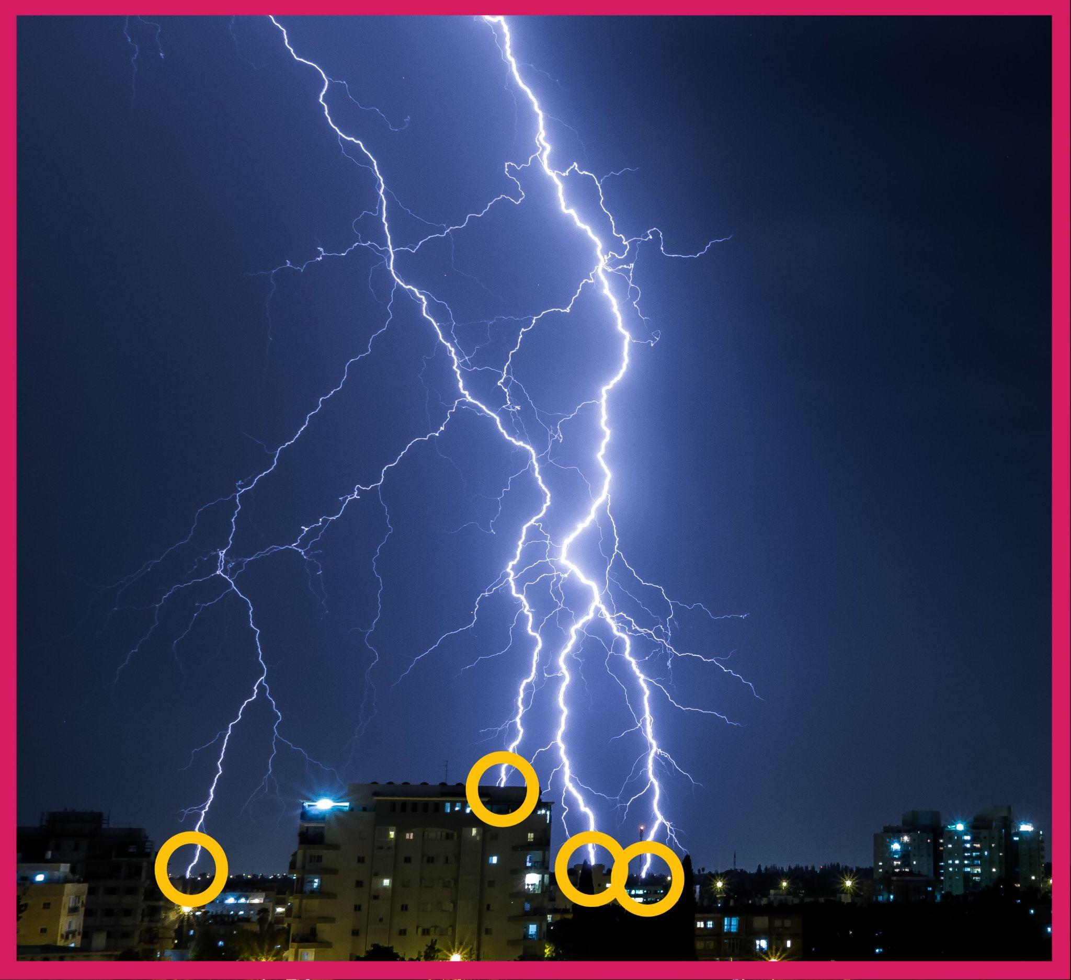
Slide FF (optional)
Differentiate Flashes and Strikes
Pink outline = flash (everything you can see at this moment)
Yellow circles = strikes (where lightning hits the ground or an object)
Yoav Azis on Unsplash
Notes:
DO NOT DELETE THIS TEXT
If your students notice that the map is counting lightning flashes while the chart is counting lightning strikes and ask if there is a difference, you can clarify those terms. A lightning flash includes all the lightning visible in that moment, whereas a strike means actual ground (or building, tree, etc.) contact. So, a flash can include multiple strikes. See optional slide DD for a labeled photo. These terms are not critical to the sensemaking of this unit, so it is not necessary to explain them unless students bring it up.

Slide 33
Slide GG (optional)
Prepare and Organize Our Notebooks
In your notebook
Add 10 pieces of notebook paper to a section of your binder. This will be your Progress Tracker section.
Place a divider and add the rest of your work from Lesson 1 after that divider. Title any page that does not have one already. Number and date each page.
Repeat the tasks in the previous bullet at the end of each lesson to keep your notebook organized.
Notes:
DO NOT DELETE THIS TEXT
Keeping a science notebook allows students a space where they can reflect and communicate their developing understandings about science ideas and track changes in their understandings.
If your students have not yet added on to their notebooks for the new unit, ask them to designate a section of their 3-ring binder for the current unit. They will keep all of their handouts and notes organized there. They should use dividers and/or sticky note tabs to keep 3-hole-punched handouts and notes on loose-leaf paper organized within this unit section. Optional slide EE is provided for you to use or modify to give students instructions on setting up their notebooks.

Slide 34
Licensing Information
Chemistry Unit C.2 Lesson 1 Slides. OpenSciEd. CC-BY-NC 4.0
Visit this page for information about the license and this document for information about the proper attribution of OpenSciEd materials.

